Slide 1

29/Nov - 2011
Defense of PhD Dissertation
Using
Infrastructure Awareness
to Support the Recruitment of
Volunteer Computing Participants
Juan David Hincapié-Ramos – jdhr@itu.dk
Notes:
Thanks Jakob for the introduction, and to the members of the committee: Anker Jorgensen, Kasper Hornbæk and Carl Gutwin for being here today.
I would also like to greet my supervisor Jakob Bardram, my co-author in much of this work Aurelien Tabard, the members of the PIT lab, the Software Development Group, and the respectable members of the audience.
Thank you all for coming!
Today, I am presenting the work I have done during my PhD and it’s titled:
Using Infrastructure Awareness to Support the Recruitment of Volunteer Computing Participants.

Slide 2
Using
Infrastructure Awareness
to Support the Recruitment of
Volunteer Computing Participants
Notes:
This title is quite telling and I will use it to illustrate the overall work.

Slide 3
Using
Infrastructure Awareness
to Support the Recruitment of
Volunteer Computing Participants
[Context]
Notes:
The first element to highlight is the context within which this work is located: volunteer computing.
As we will see later, volunteer computing deals with computational systems that allow us to distribute tasks to remote volunteered machines.

Slide 4
Using
Infrastructure Awareness
to Support the Recruitment of
Volunteer Computing Participants
[Problem]
Notes:
Within volunteer computing, there are plenty of technical problems like the distribution of tasks.
But there are also more human problems, one of which I studied and is how to recruit participants that can give you the computers you need to run your volunteer computing project.

Slide 5
Using
Infrastructure Awareness
to Support the Recruitment of
Volunteer Computing Participants
[Conceptual Approach]
Notes:
For dealing with this problem I propose a concept called Infrastructure Awareness!
Which is based on studies of infrastructures and how we interact with them.

Slide 6
Using
Infrastructure Awareness
to Support the Recruitment of
Volunteer Computing Participants
[Design + Development + Evaluation]
Notes:
Finally, this is an experimental work, which means that we used the infrastructure awareness concept for guiding the design, development, deployment and evaluation of a couple of technologies.

Slide 7
Agenda
Part I – Introduction
Volunteer Computing and
Participative Computational Infrastructures
Participant Recruitment
Existing Research
Infrastructures and Invisibility
Infrastructure Awareness
Part II – Design
Part III – Evaluation
Part IV – Discussion
Notes:
As you could see from the title itself this is a large work, and therefore I will divide the presentation in 4 parts
The first part is the introduction; which will set the stage by laying down the theoretical foundations of this work:
- I will introduce volunteer computing and the participant recruitment problem.
- We will look at existing approaches to tackle this problem.
- And finally, I will introduce what I believe is the core of the problem (the invisibility of computational infrastructures) and the proposed conceptual solution (the concept of infrastructure awareness).

Slide 8
Agenda
Part I – Introduction
Part II – Design
Fieldwork Studies
Design Process
GridOrbit Public Displays
GridOrbit Notification System
Part III – Evaluation
Part IV – Discussion
Notes:
In the second part, we will look at how this theory is articulated into the design of two infrastructure awareness systems: GridOrbit public display and GridOrbit notification system.
I will briefly present the fieldwork studies that informed our designs, and the particular design process we followed.

Slide 9
Agenda
Part I – Introduction
Part II – Design
Part III – Evaluation
Study Setup
Quantitative Results
Usage Patterns
Adoption Impact
GridOrbit Usage
Motivations
Part IV – Discussion
Notes:
The third part will concentrate on the in-the-wild evaluation of the Mini-Grid and the GridOrbit systems.
And we will look at the study set-up, and the many results derived from the data we captured.

Slide 10
Agenda
Part I – Introduction
Part II – Design
Part III – Evaluation
Part IV – Discussion
Hypotheses
Hypothesis Analysis
Volunteer Computing Case
A World of Infrastructures
Conclusions
Notes:
The fourth and final part will reflect on the whole exploration, by looking at the different hypotheses implicit in our approach and designs,
and comparing them to the results we captured.
Then, I will present a couple of reflections: The first, about applying infrastructure awareness to volunteer computing.
And the second, about how I see infrastructure awareness play out in a world full of computational infrastructures.

Slide 11
Introduction
Part I
Notes:
Let’s start with the first part: The Introduction

Slide 12
Agenda
Part I – Introduction
Volunteer Computing and
Participative Computational Infrastructures
Participant Recruitment
Existing Research
Infrastructures and Invisibility
Infrastructure Awareness
Part II – Design
Part III – Evaluation
Part IV – Discussion

Slide 13

BOINC
Mini-Grid
distributed.net
OurGrid
IBM’s WCG
+12 more…
Notes:
The research leading to my dissertation, and the context of this work, is a volunteer computing system called the MiniGrid.
A Mini-Grid is a dristibuted computing infrastructure where users voluntarily donate computing power to execute everyone’s tasks.
[CLICK]
So, tasks that were previously executed in a single machine are broken down into pieces and distributed among the Mini-Grid members.
[CLICK]
As more computers join the minigrid, its capacity increases, and there are gains in robustness and stability.
[CLICK]
Like the Mini-Grid, there exists other similar infrastructures like BOINC (which supports the seti@home project), OurGrid or IBM’s World Community Grid.

Slide 14




Participative Computational Infrastructures are infrastructures that depend on their participants’ use of a computational system to provide a service, with every instance of the system executing tasks of a similar nature, and collaborating with others.
Computing Power
Storage
Network
Reasoning
[Participative Computational Infrastructures – Page 21 & 47]
Notes:
The success of platforms like BOINC with 37 projects and more than 2 million participants inspired innovators to try different ways to tap into the collective resources of internet volunteers,
for sharing not only computing power, but also other resources like storage, network connectivity, and human intellect.
[CLICK]
This more general class of infrastructures is what I call Participative Computational Infrastructures, and are defined as infrastructures that depend …

Slide 15
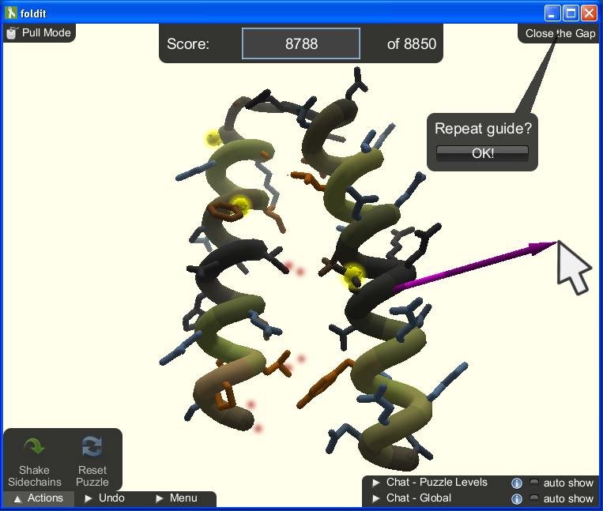
[FoldIt – 57.000 participants Aug/10]
Notes:
Examples of participative computational infrastructures include FoldIt, where over 57.000 participants fold proteins as if it was a game.

Slide 16
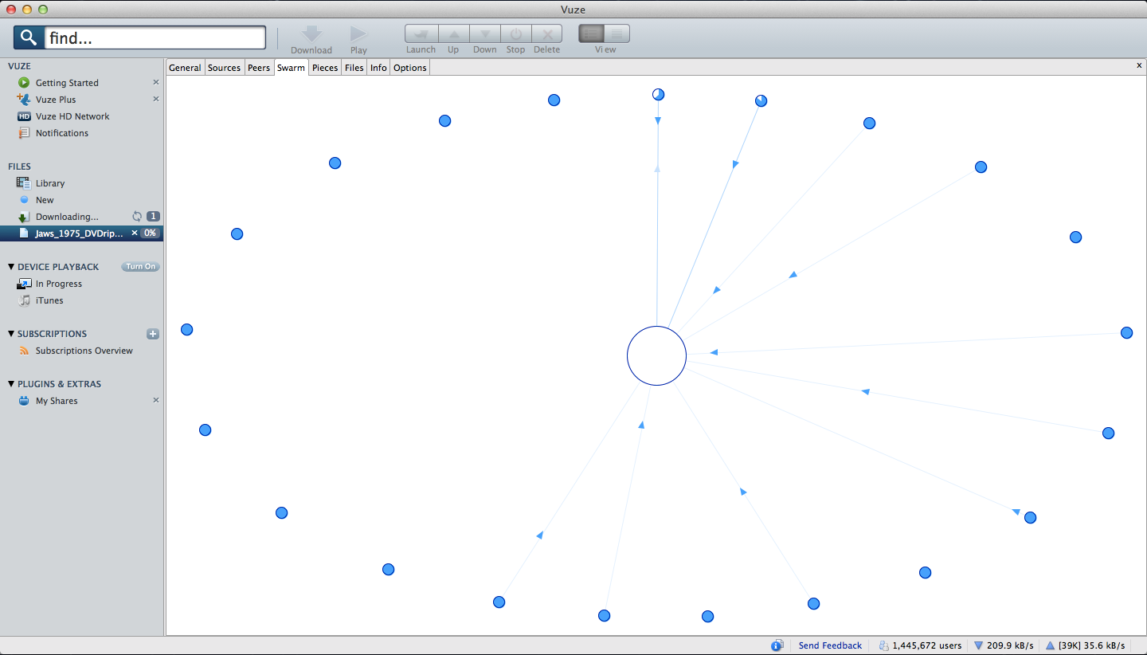
[BitTorrent – Vuze client’s Swarm view]
Notes:
BitTorrent, where millions of participants share their data files; mainly music and videos.

Slide 17
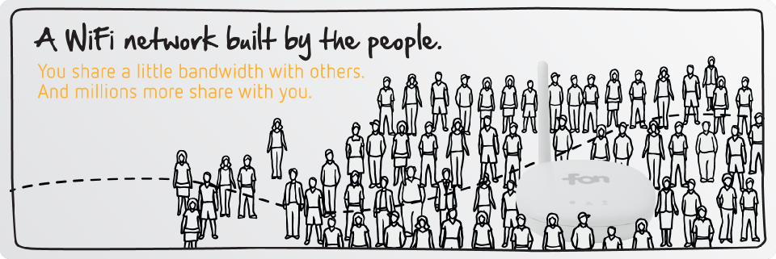
[FON WiFi network – over 4 million FON spots May/11]
Notes:
And FON, where by May 2011 there were over 4 million shared WiFi connections available.
As you can imagine, each of these infrastructures have very complicated technical problems to solve:
like task distribution in volunteer computing,
or file redundancy in BitTorrent,
or network security in FON!

Slide 18
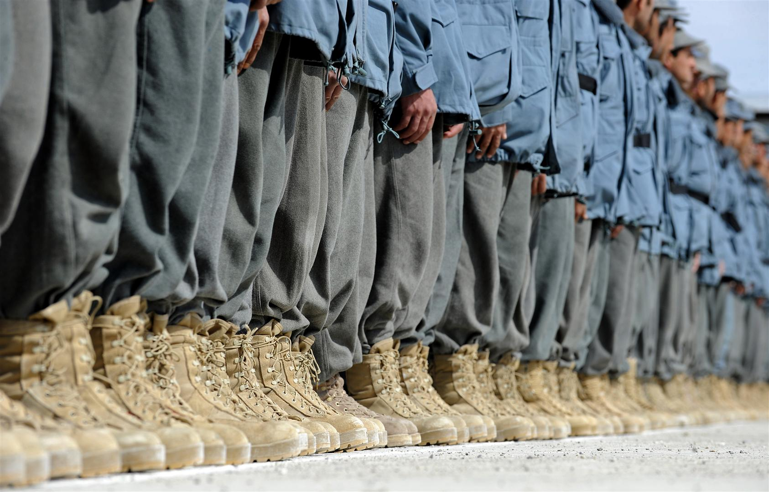
Regardless of how good, efficient or secure the computational aspect is, these infrastructures cannot provide the service they are designed for without a good number of participants [Butler’01 cited in page 17].
Notes:
However, and let me quote myself here quoting Butler: regardless…
Which basically means, we need to get people using the system in order for the system to provide real value.

Slide 19
Related Work
Technical Support
Motivational Factors
[Led by practitioners]
[Led by researchers]
Notes:
If we stay focused on the recruitment problem, there are two mayor lines of work: One, led by researchers, studies the motivations people have to participate in such efforts.
And another one, championed by practitioners, relates to the technical tools and strategies that support the recruitment and maintenance of participants.

Slide 20
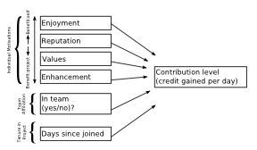
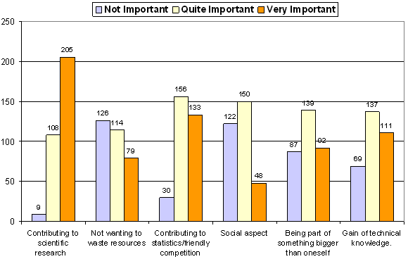
Related Work
Motivational Factors
Motivational Models
Survey Studies
Motivation Techniques
Persuasive Technologies
Notes:
Let me start with the motivational factors:
This line of research focuses on the motives that come into play when a person participates.
The general topics within this line of research include defining a motivational models,
validating these models with participants through user studies (survey, interviews),
and, sometimes, comparing the reported motivations with the participant’s actual contributions.
All this work with the longer term goal of suggesting what kind of technologies should be built to support this kind of participation.
However, at the time of writing there was work only in the models and the studies, and only some references to the possible use of motivation or persuasive techniques.

Slide 21
Related Work
Motivational Factors
Contributing to scientific research
Friendly competition
Prospective gain of technical knowledge
Point systems and rewards
Sense of community
[Hologan and Garg’05 – Motivational Models]
Notes:
One of the first and simplest studies was carried out by Hologan and Garg, who identified the most important motivations as reported by participants.

Slide 22
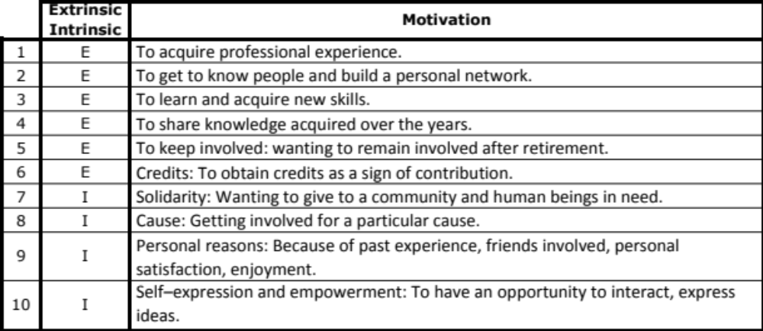
Related Work
Motivational Factors
Krebs’10
[Motivational Models]
Notes:
Another example of the more descriptive studies is Kreb’s analysis of participants to the MalariaControl.net project.
Krebs defined a motivational model based on a set of intrinsic motivations and a set of extrinsic motivations.
And she found out that participants favored motives like solidarity, enjoyment and the support for good causes as the most important ones when starting to participate.
And personal satisfaction, collecting points, and learning experience as the most relevant ones for sustained engagement.

Slide 23
Related Work
Motivational Factors
Nov et al.’10
[Motivational Models]
Notes:
There have been several studies of motivations by researchers like Hologan and Garg in 2005, or by Krebs in 2010.
However, a more complete example is Nov et al’s study of BOINC contributors.
Their model includes both intrinsic and extrinsic motivations, team affiliation and the length of the participant’s tenure.
This study shows that there are different motivations at play for joining (short term) and for continuing contributing for long periods (long term):
- in the short term personal/intrinsic motives like enjoyment, reputation and the values of the project clearly have a positive impact on how much the participant contributes.
- however, personal motives alone do not support long term enrollment, but that social motives do – like being part of a team.

Slide 24
Related Work
Motivational Factors
Overview and statistics [Krebs’10]
Improved communication about what’s going on (results) [Krebs’10]
Increased awareness [Krebs’10]
Sense of community [Hologan and Garg’05]
Up-to-date individual contributions [Nov et al.’10]
Multiple feedback channels [Nov et al.’10]
Contributions in relation to others [Nov et al.’10]
Enjoyable user interface [Nov et al.’10]
[Motivational Techniques]
Notes:
As I mentioned before, there isn’t any work clearly linking those motivational studies to particular pieces of technological support.
But nonetheless, these efforts have led to a set of recommendations including…

Slide 25





Related Work
Technical Support
User
Involvement
(Inwards)
User
Involvement
(Outwards)
Active
Feedback
Improved
Interaction
Basic Set
User Generated Content
Information Website
Result Dissemination
Fairness Mechanisms
Promotional Tools
Catchy Name
Leader Boards
Screen Saver
User Profiles
Newsletter
Challenges
Social Media
Playfulness
Teams
Points
Forum
Chat
Badge
[Technological Support for Recruiting Participants – Page 27]
Notes:
ADD PAGE NUMBER
On the other side of our related work, practitioners have been exploring multiple tools to support the participants involvement with the projects.
For this analysis we surveyed 52 participative computational infrastructures where we identified some of the technical tools they use.
The table shows five groups of tools
- The Basic Set (tools attracting participants and providing basic feedback) -
- Active Feedback (to reach out to participants) – chat service, newsletters, and the dissemination of results
- Inwards User Involvement (to increase the participants’ use of the system) – challenges, user generated content, badges
- Outwards User Involvement (to use the participants to recruit new ones) – social media, promotional tools (mugs, shirts)
- Improved Interaction (to reward participants) – fairness mechanisms, playfulness
We tried to see which of this tools were used by different projects.
[CLICK] - [CLICK]
The color represents the percentage of projects that implement a given feature within a type of PCI.
The most outstanding feature of the table is that the basic set is really the de-facto minimum set of features that current projects use – specially for volunteer computing.
The table also points out new features that are receiving considerable attention like the dissemination of results and the use of social media.

Slide 26
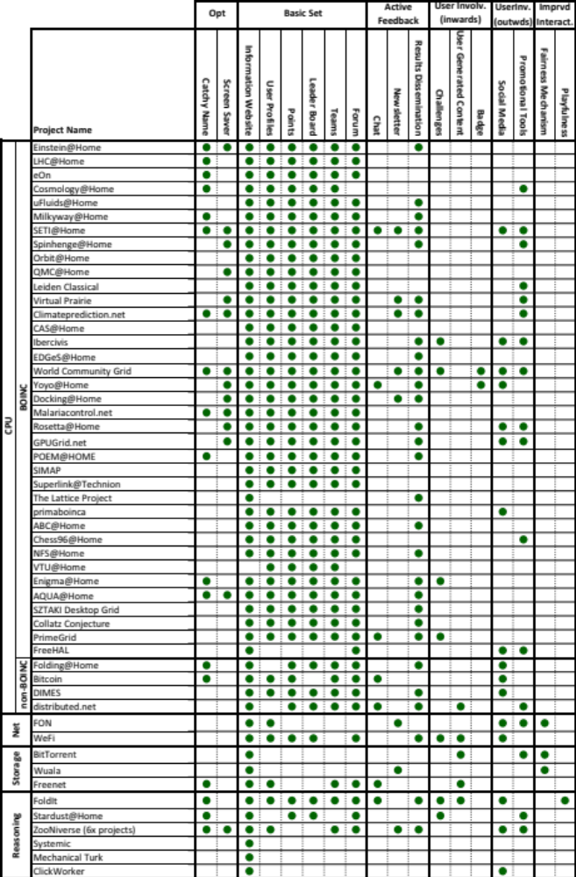
Notes:
The classification looks like this but, for the sake of this presentation, I will present the cumulative.
[BACK]

Slide 27
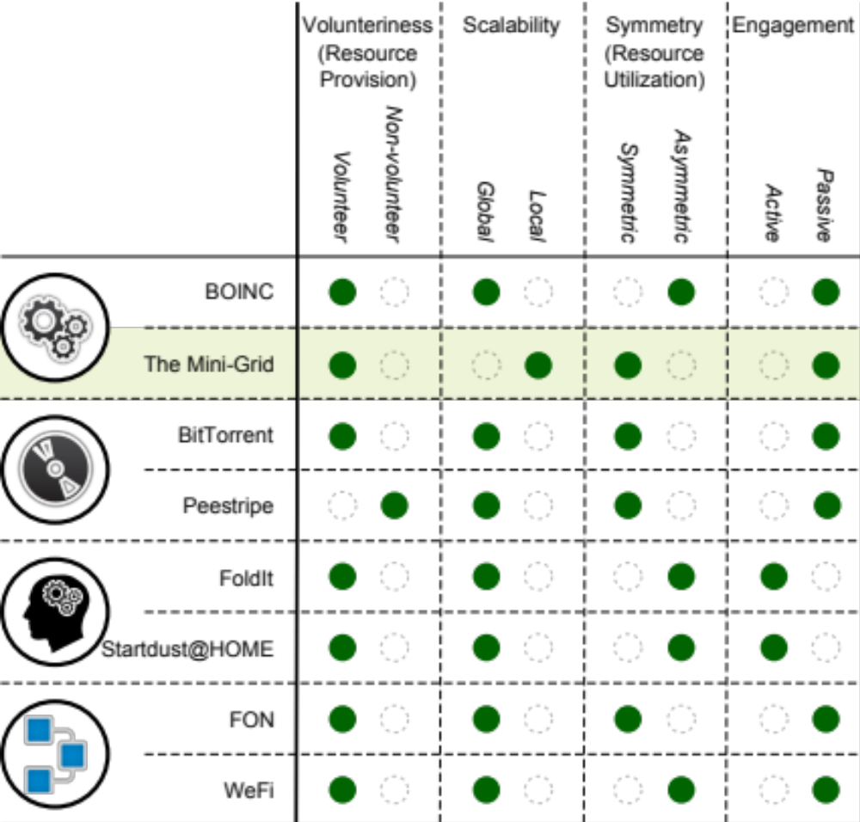
[Technical properties derived from the ones identified by Venkataraman’11 and Benkler’06]
Notes:
In order to better understand the best approach to support the recruitment of participants for the Mini-Grid we looked at multiple technical properties that relate to its participative aspect,
and how they map to other systems.
Some of this properties are:
- voluntariness (whether participation is voluntary),
- scalability (whether is a local system, or it covers large geographical areas),
- symmetry (whether participants can also benefit from the infrastructure), and
- engagement (what’s the amount of work participants have to put in)

Slide 28
Notes:
For the Mini-Gird, being local means that participants are likely to know each other.
And being symmetric means that participants not only contribute to the system, but can also benefit from its services.
Moreover, it also means that the management of the Mini-Grid falls on the hands of its own participants:
they are not only contributors, or users, but also administrators of the system.
However, being a passive infrastructure means that users do not have to engage with the Mini-Grid in order to contribute,
leading to an almost invisible UI design.

Slide 29

[The Mini-Grid is invisible]
Notes:
For example, this is how running the Mini-Grid client looks like…. There is nothing!
Although your machine is contributing to this shared infrastructure, it remains invisible to the participants.

Slide 30
Poole et al. studied this invisibility in home network systems [Poole et al.’09] and RFID technologies [Poole et al.’08]. Their findings suggest that invisibility hinders trust and adoption, and keeps users from forming correct mental models of the
infrastructure.
[Why invisibility is not a desirable feature – Page 49]
Notes:
This is an important observation, because there is a growing consensus within the Ubicomp and HCI communities about the inconvenience of infrastructural invisibility.
For example…
Therefore, the invisibility of the Mini-Grid is the first challenge for recruiting new participants, prior to motivational models or motivation techniques.

Slide 31
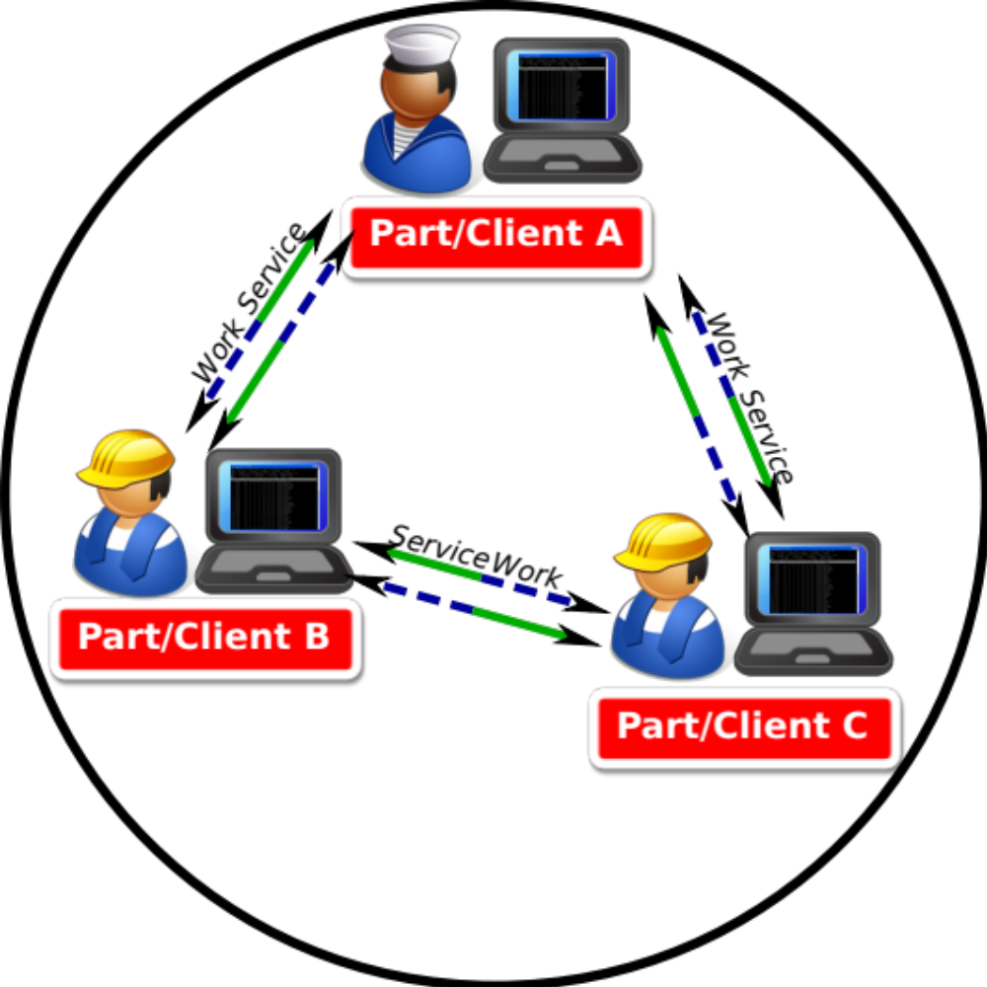
[Symmetry – Page 52 bottom]
Notes:
Let me stress this out again,
the invisibility problem is particularly acute for a symmetric infrastructure like the Mini-Grid, where its participants are both USERS and administrators (NON-USERS) of the infrastructure.
Participants are part of the infrastructure itself, and have to make sure that the Mini-Grid runs properly.

Slide 32

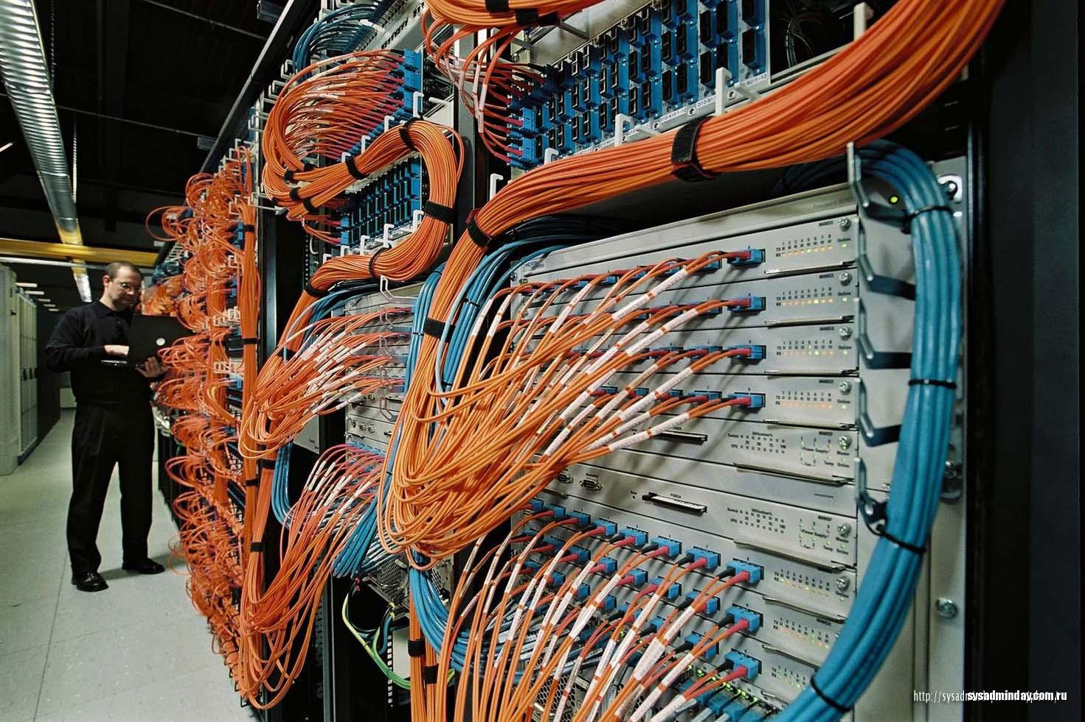

Dual role
Notes:
The way a user or an administrator interacts with the system are different,
and therefore the user interfaces to support this interactions should be different too.
[CLICK]
As a user, the participant is more interested in using the grid and obtaining results.
[CLICK]
As an administrator, the participant should look after the current state of the grid, the amount of participants, the actual load, etc.

Slide 33
How can we design the interactions between the participative computational infrastructure and its participants, in a way that satisfies the needs of these two roles?
Notes:
Therefore, the research question we really want to explore, is how can we….

Slide 34
[Invisibility and Embodiment – page 52]
Infrastructures == Heidegger's equipment
present-at-hand
ready-to-hand
Dual role
Notes:
To help us answer this question, we analyzed the relational nature of such infrastructures, and link it to Heidegger’s notion of equipment.
According to Heidegger, equipment works in two ways: ready-to-hand and present-at-hand.
In ready-to-hand case, we use equipment without thinking about it, but rather thinking about the action we are performing.
In the present-at-hand case, it’s the equipment itself that we think about.
For volunteer computing we should also be able to do that: to participate without thinking about it, but also to be able to really look at the infrastructure when performing the necessary administrative tasks.

Slide 35
Dourish’s Embodied Interaction
Embodied Interactions
… are those that we can understand and form correct mental models for
because they occur in real-time and real-space.
Accessible in the Background
… systems need to provide ways for users to move between
ready-to-hand (background) and present-at-hand (focus)… [and] moving
between the two is a fundamental part of embodied interaction…
[Dourish’01 cited in page 54]
Notes:
To better understand what these two perspectives mean for designing technological support for volunteer computing, we looked into Paul Dourish’s embodied interaction
Dourish talks about a kind of interactions, he calls Embodied Interactions, that given their nature users can understand and form correct mental models for.
Based on the present-at-hand and ready-to-hand perspectives, Dourish says that such embodied interactions must allow users to move between this two perspectives – providing a kind of accessibility in the background.

Slide 36
Infrastructure Invisibility Awareness
Detailed Visualization
Awareness Visualization
(invisible)
Present-at-Hand
Move on Request
Ready-to-Hand
Non-User
Monitoring
Management
User
Contributing
Using it
Notes:
What it means for the Mini-Grid is that:
[CLICK]
it must be possible for a participant to visualize the system in a non-obtrusive, ambient and background way,
[CLICK]
and to also have a detailed visualization that he could engage with when necessary.
[CLICK]
And allowing the user to switch between this two perspectives at will.

Slide 37
Infrastructure Awareness is a feedback mechanism on the state of, and changes in, the properties of [computational] infrastructures provided in the periphery of the user’s attention, and supporting gradual disclosure of detailed information on user’s request.
Notes:
This realization gives way to our proposed notion of infrastructure awareness and this is how we end the first part:
[READ]

Slide 38
Design
Part II
Notes:
Part II: Design

Slide 39
Agenda
Part I – Introduction
Part II – Design
Fieldwork Studies
Design Process
GridOrbit Public Displays
GridOrbit Notification System
Part III – Evaluation
Part IV – Discussion

Slide 40
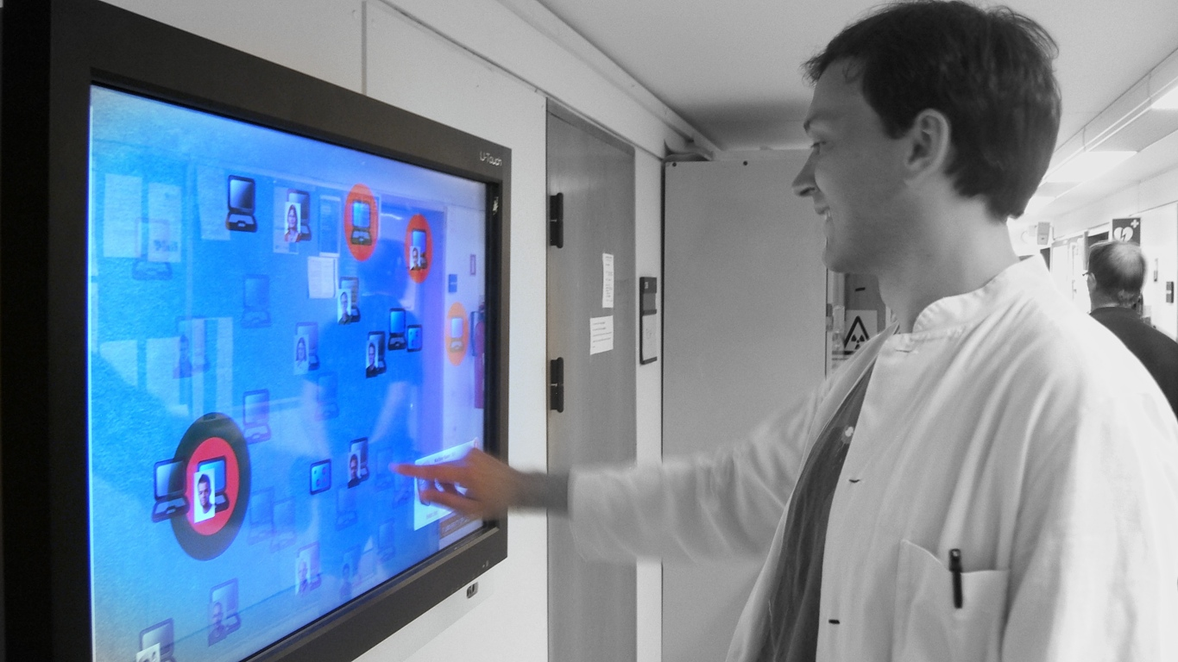
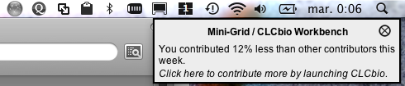
GridOrbit
Public Displays
Notification System
1
2
Notes:
In this part we articulate the concept of infrastructure awareness and use it for the design of two systems to support the recruitment of participants to the Mini-Grid.:
[CLICK]
- a set of public public displays, and
[CLICK]
- a desktop notification system.

Slide 41
Notes:
Here is one of GridOrbit’s public display used by a biologist.
The public display shows computers participating to the Mini-Grid.

Slide 42
Notes:
And here is one of GridOrbit’s notificaction.
They appear on Personal Computers and invite for more participation
For instance by comparing how much one participant contributed compared to others.

Slide 43
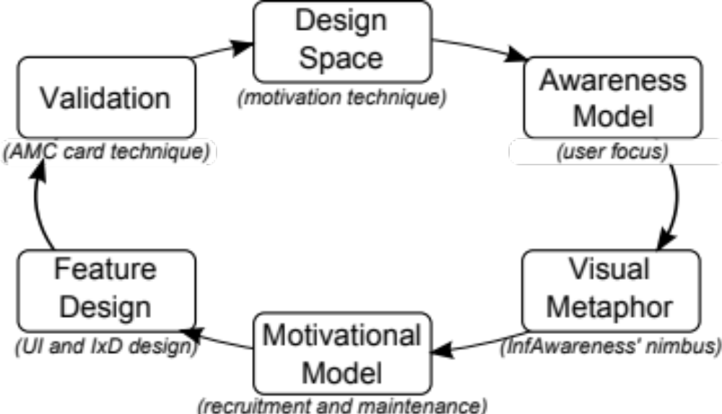
Fieldwork Studies
Design Process
Notes:
Designing these systems followed a two step approach:
In the first step, we carried out fieldwork studies of the future users of the MiniGrid.
In the second step, we followed an iterative design process for each of the systems.

Slide 44
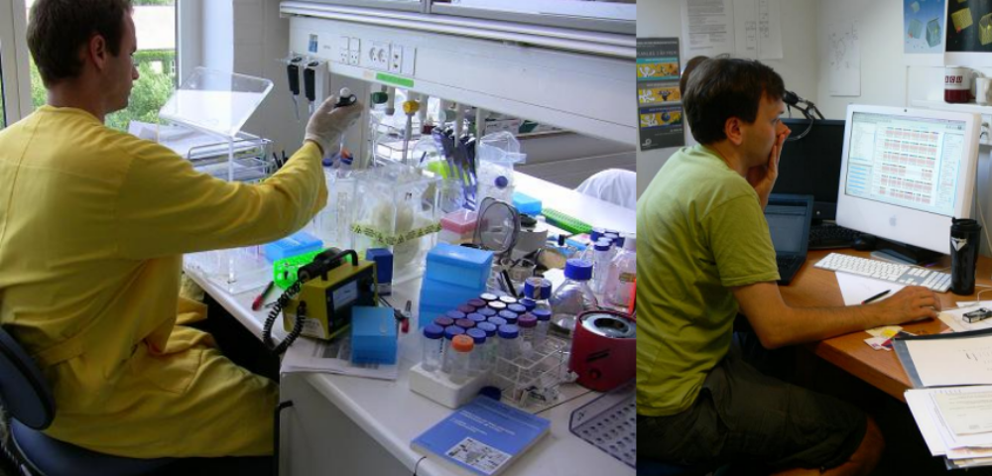
What are the opportunities for the development of infrastructure awareness systems for the Mini-Grid based on the existing infrastructures and sharing practices?
[Studies of Biologists at Work – Chapter 4]
Notes:
During the fieldwork, and given that the MiniGrid is mainly a local infrastructure, we looked into how biologists used their existing infrastructures and
what are their sharing practices.

Slide 45
Place-based observations – the lab
Event-based observations – the experimental execution
Open ended and semi-structured interviews
Video recordings and pictures
Notes:
The fieldwork used traditional user studies tools like
- place-based observations of the lab
- event-based observations of experimental executions
- open ended and semi-structured interviews
all of which was documented with videos and pictures.

Slide 46
Work Processes
Equipment
Infrastructures
Sharing Practices
Group Composition
Physical Spaces
Notes:
We analyzed the data by grouping it into different categories including:
- work processes.
- laboratory equipment
- group composition, and
- physical spaces
We further did contextual analysis on the topics of infrastructures for biology research and the existing sharing practices.

Slide 47
Fieldwork Results
Awareness mechanisms are already in use in their simplest form.
Recruitment could target both research and administrative personnel.
Multiple technological mechanisms covering the different locations where they work (lab/office).
Notes:
The fieldwork revealed a series of facts like:
- Biologists already use simple awareness mechanisms to mediate access to shared resources → This is important because we are trying to use a similar, yet more advanced, approach
- Recruitment could target both research and non-research personnel → This is important because we do not care who they are as long as they have a computer
- Technical support for recruitment should take into account the high mobility of biologists, and perhaps provide different technologies for when they are in the lab and when they are at the office.

Slide 48
Fieldwork Studies
Design Process
[Design Process – Chapter 4 – Page 87 & 94]
Notes:
Based on these findings we set out to design technologies that could support the Mini-Grid.
For such end, we carried out an iterative process with a series of participatory design workshops.
[CLICK]
Now, I will present the different parts of our design process, and for the sake of brevity, I will illustrate each step with the design of GridOrbit public display.

Slide 49
Notes:
The first step is to identify the kind of tool we wish to build.
For this we used a design space definition.

Slide 50
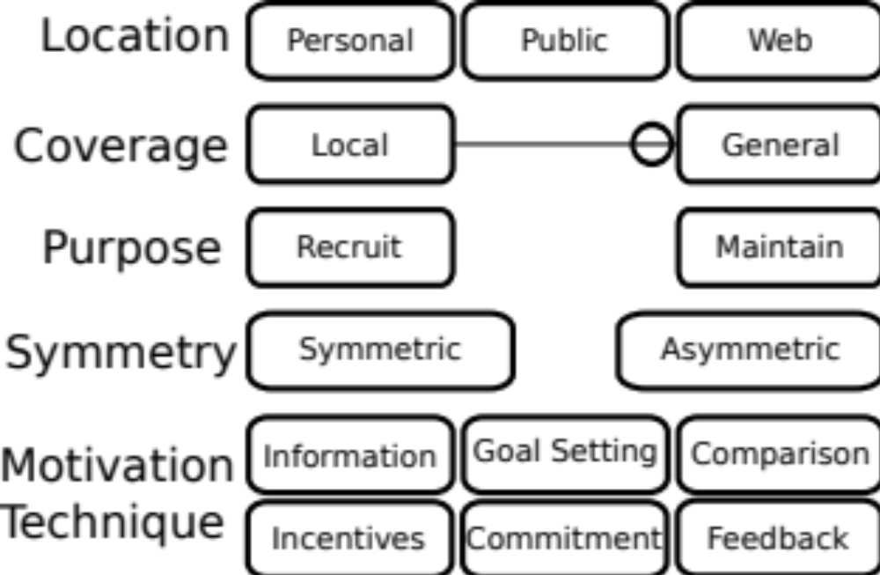
[Design Space for Technological Support for V.C. – Page 82]
Notes:
We used the 18 technical support tools we identified in the related work to define the design space.
According to the design space, a solution will have a location or an intended audience (personal, public, or web),
a coverage or how much of the infrastructure it reports on (it is a continuous value from local to general),
a purpose in relation to participants (recruitment of maintenance, or both).
A solution is also aimed at either a symmetric or an asymmetric system,
and finally the designer can choose between different motivation techniques documented in the literature.
[CLICK]
GridOrbit public display is aimed at public places, and presents a general view of the whole Mini-Grid.
As a public system it has the dual goal of maintaining existing participants by providing them with feedback and recruiting new ones by attracting their attention.
It is designed for a symmetric system which is the Mini-Grid.
And finally it uses two simple motivations techniques: information and feedback.

Slide 51
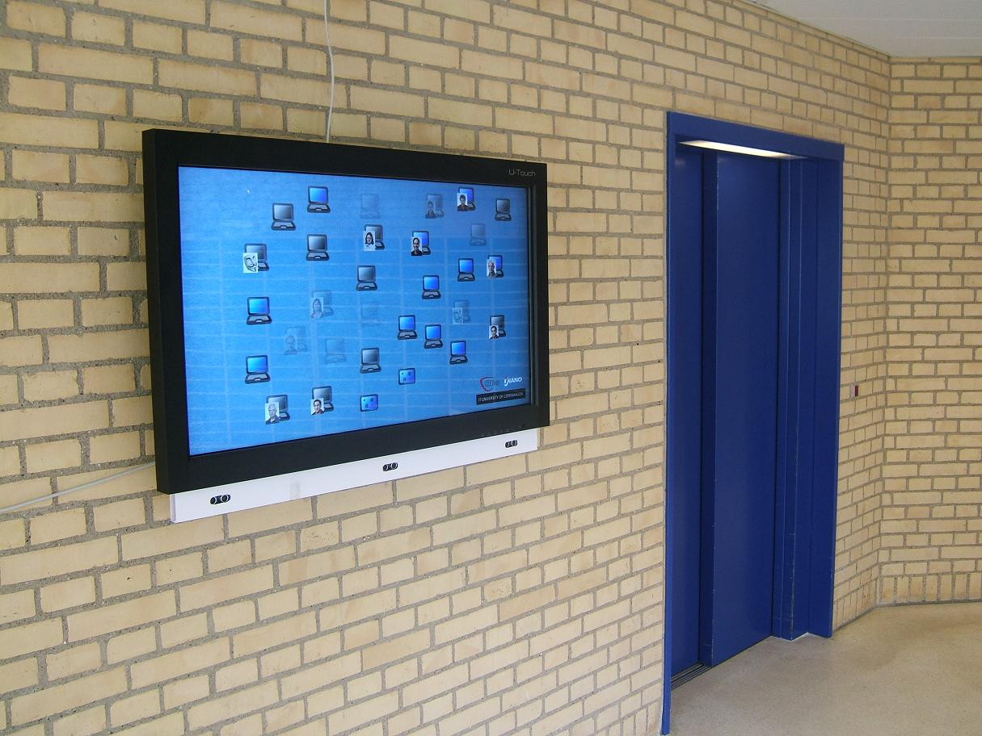
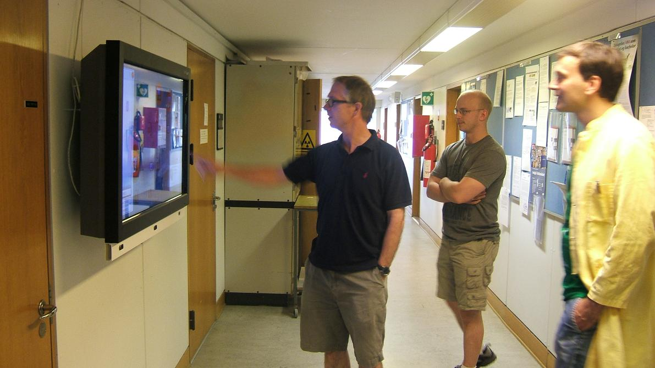

Building 1:
Corridor in front of the Cafeteria
Building 2:
Elevator +Mail Box Waiting Area
1
Gridorbit Public Displays
Notes:
These pictures show the actual installations of GridOrbit we made, and the guys in the picture are actual biologists.
[CLICK]
In the first building we placed the public display in the corridor in front of the cafeteria.
[CLICK]
In the second building we placed it in the waiting area next to the elevator and the local mail-boxes.

Slide 52
Notes:
The second step in our design process is the formalization of awareness.
The basic question to answer here is: what do we want to participants to be aware of?

Slide 53
Infrastructure Awareness Model
O
Nimbus
What the entity projects about itself
Focus:
What the entity is interested in
[The spatial model of interaction – Page 56]
Notes:
To help answer this question we modelled infrastructure awareness on Benford and Fahlen’s spatial model of interaction.
[CLICK]
According to the spatial model of awareness, an entity has interests (called focus) and projects things about itself (called nimbus).

Slide 54
A
A
B
Notes:
According to the model, we say that an object A is aware of object B when A’s focus meets B’s nimbus;
[CLICK]
that is, when A is interested and has access to what B projects about itself.

Slide 55
IA
U
I
Notes:
In the context of infrastructures and their users, infrastructures are invisible and users focus on completely different things.
[CLICK]
Infrastructure Awareness systems come into the picture to translate what the infrastructure projects into the interests of the users.

Slide 56
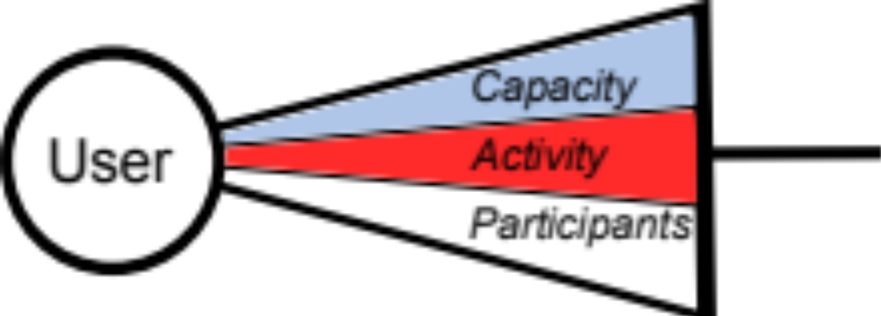
[GridOrbit’s awareness model – Page 95]
Notes:
Based on the multiple iterations over this design process, the final version of GridOrbit public display takes that participants to the Mini-Grid are interested in:
1) The capacity (state and changes of) of the Mini-Grid.
2) The activity (current and changes in) executing in the Mini-Grid.
3) The participants (current, historical) taking part of it.
What this means is that the public display system will have to provide information about this three different cues.

Slide 57
Notes:
Next, I will present the visual metaphor and the feature design steps jointly, because they are very much related and because I have a nice animation I really wanted to reuse.
Basically, the visual metaphor seeks for ways to convey the information defined in the awareness model in a way that’s visually appealing and understandable.
The feature design provides other user interface and interaction design features for an enhanced experience including the transition between awareness mode and detailed mode.

Slide 58
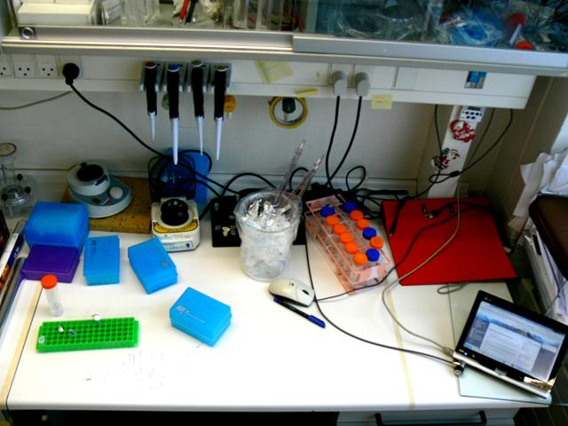
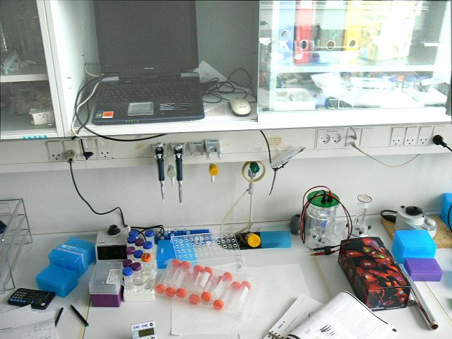
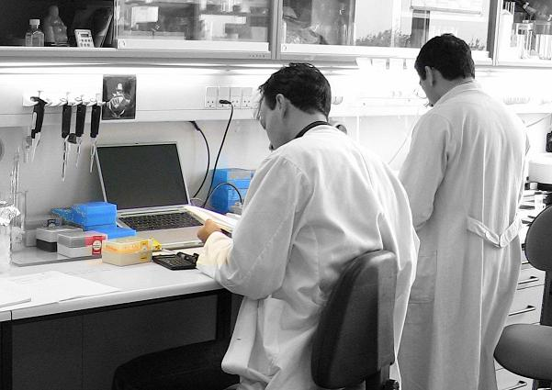
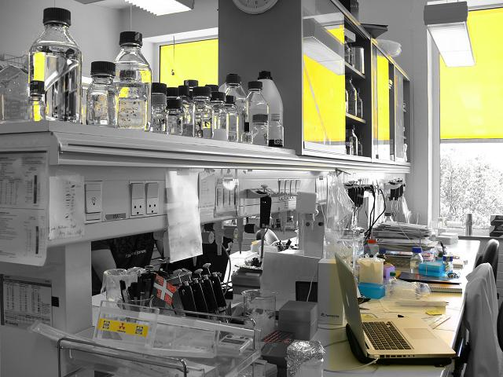

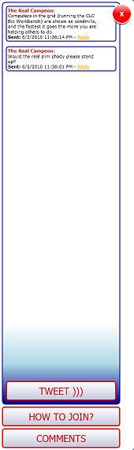



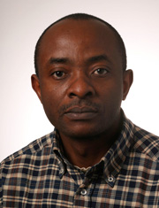
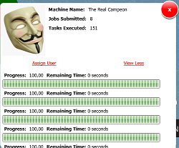
research
folding
DNA
biology
Notes:
This is how it works,
- When a user configures his computer to contribute to the Mini-Grid, GridOrbit detects it (from the network traffic) and shows it.
- This happens for every new computer that joins the Mini-Grid.
- When a computer stops contributing, is turned off, or doesn’t have network connectivity, it is grayed-out in the display.
In this way the public displays represent the capacity of the Mini-Grid: capacity in terms of the total computers that can contribute, and the ones that are currently contributing.
- When a biologist sends jobs for execution to the Mini-Grid, the public display shows a green aura around his computer.
- And the machines executing such jobs get a red aura.
- At this point a visitor to the public display can walk up to it and explore details from each machine.
In this way the public displays represent the activity of the Mini-Grid: activity in terms of the jobs being executed at given time.
- Users can also walk up to the public display and link their picture and their computers.
In this way the public display presents the individual people contributing.
Finally, visitors to the public display can leave messages on the screen, in a bulleting board fashion.
From these messages we extract the most significant words and form a tag cloud.

Slide 59
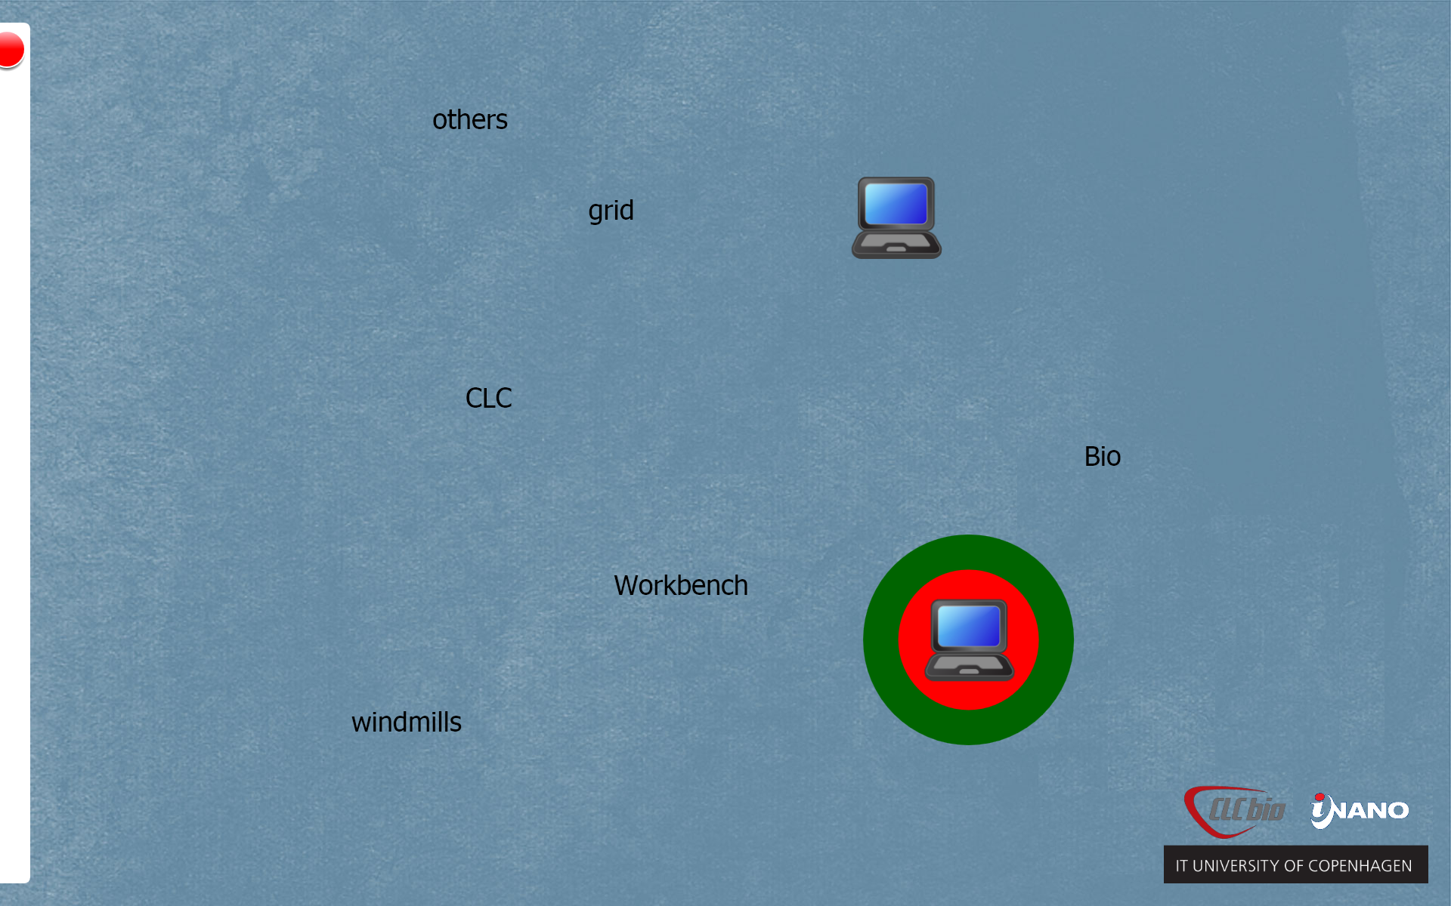
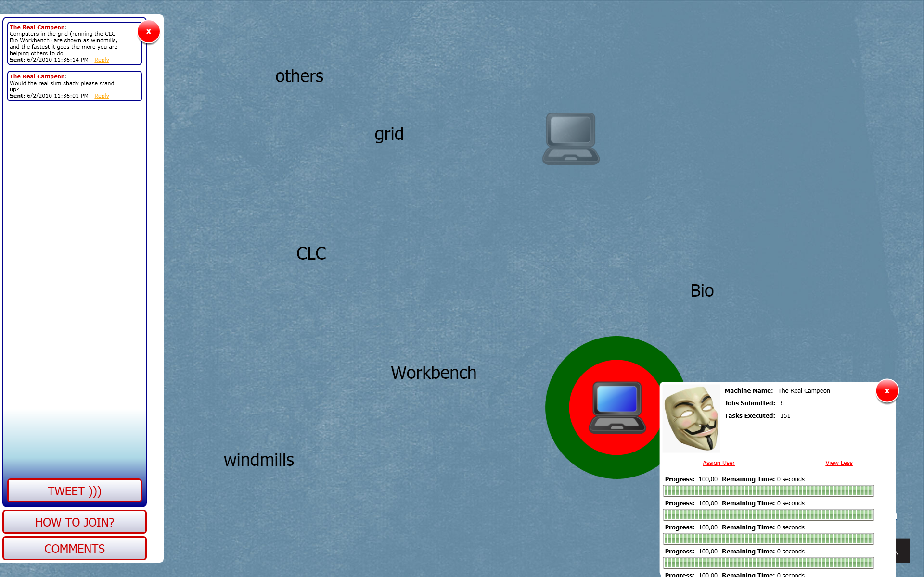
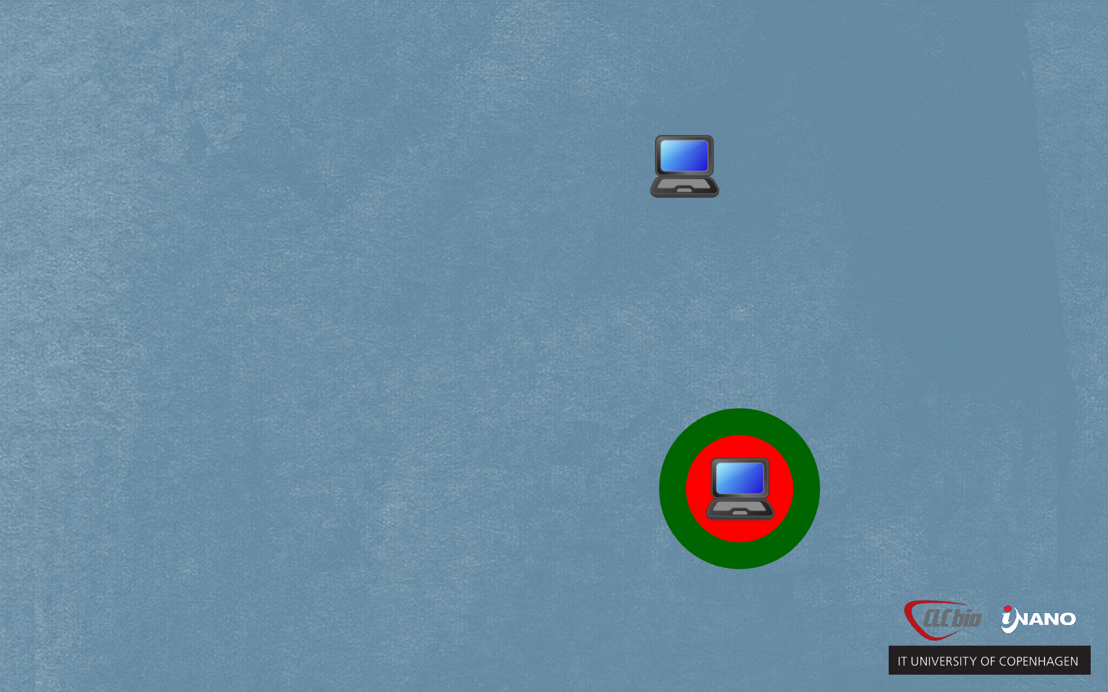

Ambient Zone
(x > 70cm)
Notification Zone
(40cm < x < 70cm)
Interaction Zone
(x < 40cm)
Notes:
When deployed, public displays become part of the environment, and as such, they should avoid information overload and change blindness.
We added three different interaction zones so that users get more detailed information when they come closer to the displays.
The AmbientZone starts after 70cm and only shows the computers and their auras.
[CLICK]
The NotificationZone is between 40 and 70 cms, and shows the tag cloud.
[CLICK]
And the InteractionZone covers the first 40 cms from the display, and shows the execution details and the messages.

Slide 60
Notes:
The step in the middle that we skipped is the definition of a motivational model.

Slide 61
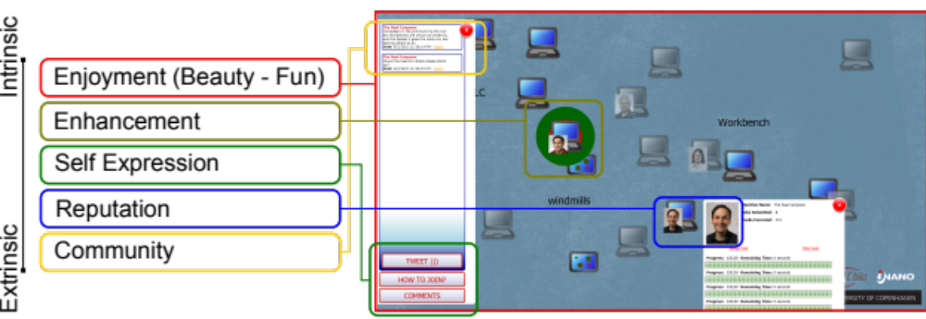
[Motivational Model – Page 97]
Notes:
We tried to design the GridOrbit visualization so that it could reflect some of the motivations that others (like Nov et al, and Krebs) have found useful for recruiting and maintaining participants.
For short term motivation we aimed for enjoyment, enhancement, and self expression.
For long term maintenance we aimed for reputation and sense of community.
This motivations explain features of the public displays that are beyond the awareness model, like the TweetBox for messaging,
or the TagCloud for browsing such messages.

Slide 62
Notes:
The final step of this iterative process is the validation of the solution.
The validation focuses on the completeness of the awareness model and the clarity of the visual metaphor.

Slide 63
IA
U
I
[The AMC Card Technique – Page 84]
Notes:
Let’s remember that Infrastructure Awareness systems come into the picture to translate what the infrastructure projects into the interests of the users.

Slide 64
AMCard Technique
IA
Nimbus Cards
The infrastructure’s
features
U
I
Focus Cards
The users’ interests
[Hincapie-Ramos, Tabard & Bardram @ DIS’10]
Notes:
However, when working on a participatory design process, users do not normally have a good understanding of the technology.
To counter this problem we used a card matching technique; our technique is based in two groups of cards, focus and nimbus cards.
[CLICK]
Focus cards, describe the users’ interests in relation to the infrastructure or the activities it supports.
[CLICK]
Nimbus cards, describe the features or possibilities of both the infrastructure and the infrastructure awareness system.

Slide 65
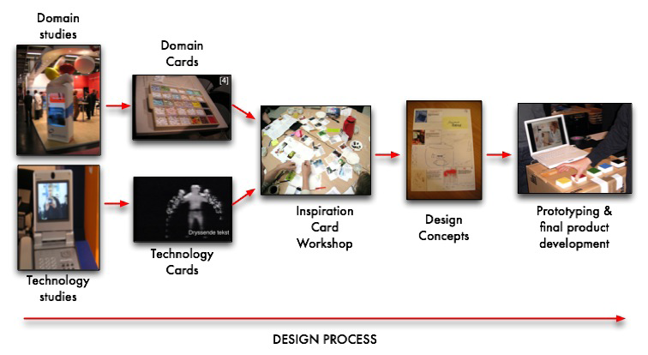
Inspiration Cards
Picture taken from the original paper: Halskov, K. and Dalsgård, P. 2006. Inspiration card workshops. In Proceedings of the 6th Conference on Designing interactive Systems (University Park, PA, USA, June 26 - 28, 2006). DIS '06. ACM, New York, NY, 2-11.
DOI= http://doi.acm.org/10.1145/1142405.1142409
Notes:
The methodological foundation, the inspiration cards workshop ,is a card matching technique used both to frame ideas of the participants, and to bring various sources of inspiration into the design process.
The activitity matches domain and technology cards with the objective of developing new design concepts.

Slide 66
Infrastructure Critique,
Implications for Redesign
User Focus Cards
Fieldwork
User Focus Cards
AMC Workshop
Design Concept
+ Closure
Infrastructure Awareness Prototype
Infrastructure
Nimbus Cards
The InfAwareness System
Infrastructure Awareness System’s Features
[Hincapie-Ramos, Tabard & Bardram @ DIS’10]
Notes:
This is the overall flow of our technique.
[CLICK]
So, by now we already have domain knowledge, an infrastrufcture, and an initial infrastructure awareness solution.
[CLICK]
We use this three elements to generate focus and nimbus cards.

Slide 67
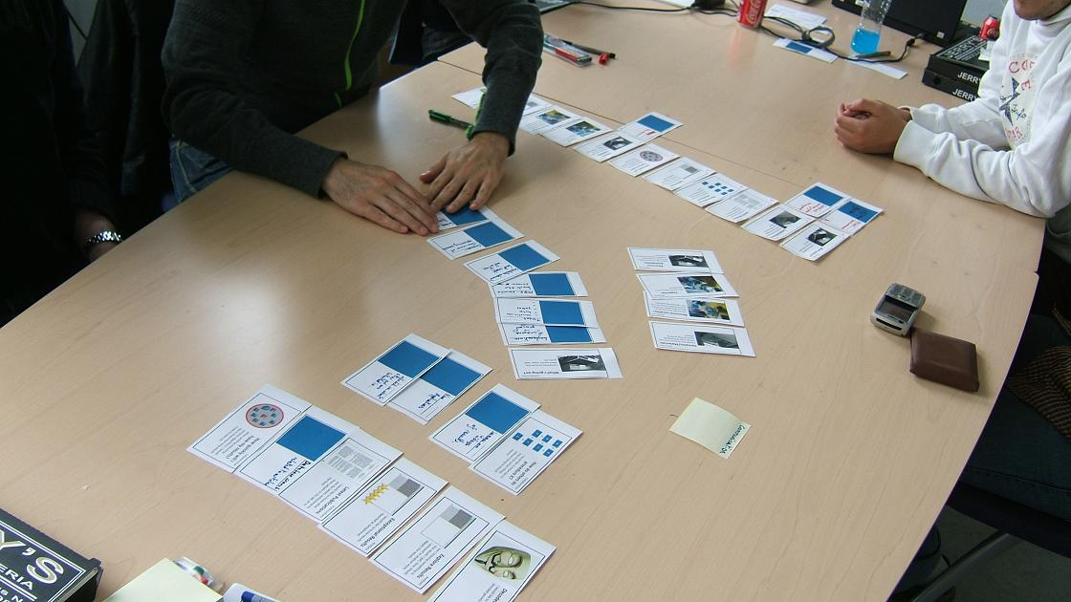
Notes:
The image shows the AMC workshop, where users matched focus cards with nimbus cards.

Slide 68
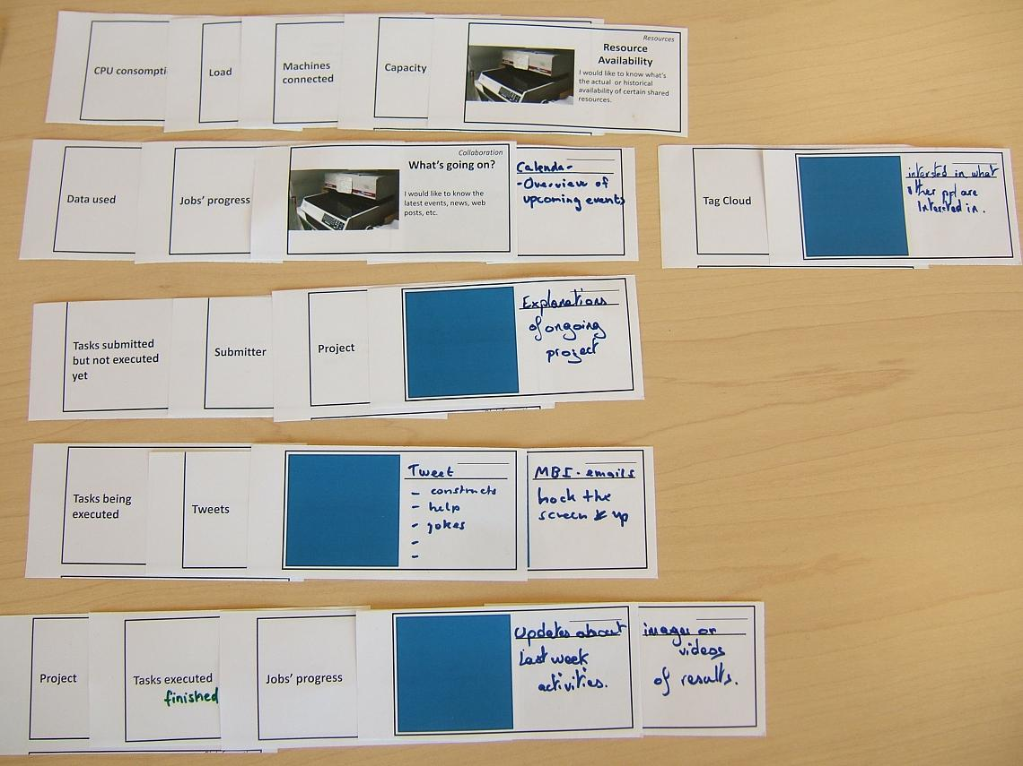
Notes:
This other image shows that users created nimbus cards describing features they would like to have, and how those features matched elements of the user focus.
[CLICK]
Following this card-matching process allowed us to identify multiple factors:
1- which of the infrastructure features being shown, but not relevant (e.g. bidding activity);
2- which of the infrastructure features not being shown, but relevant (e.g. the data used to execute a task);
3- which elements of interest the awareness system could display to engage people even though not supported by the infrastructure (e.g. latest publications).
4- which elements of the infrastructure were missing to answer users’ interests (e.g. sharing of results).

Slide 69
Notes:
We followed this process iteratively moving from low fidelity prototypes (big paper sheets) to more refined ones.
So for example, by moving along this process we explored three different visual metaphors, which you can find in the thesis:
- one with hamsters
- one with windmills
- and the final one with a tag cloud

Slide 70

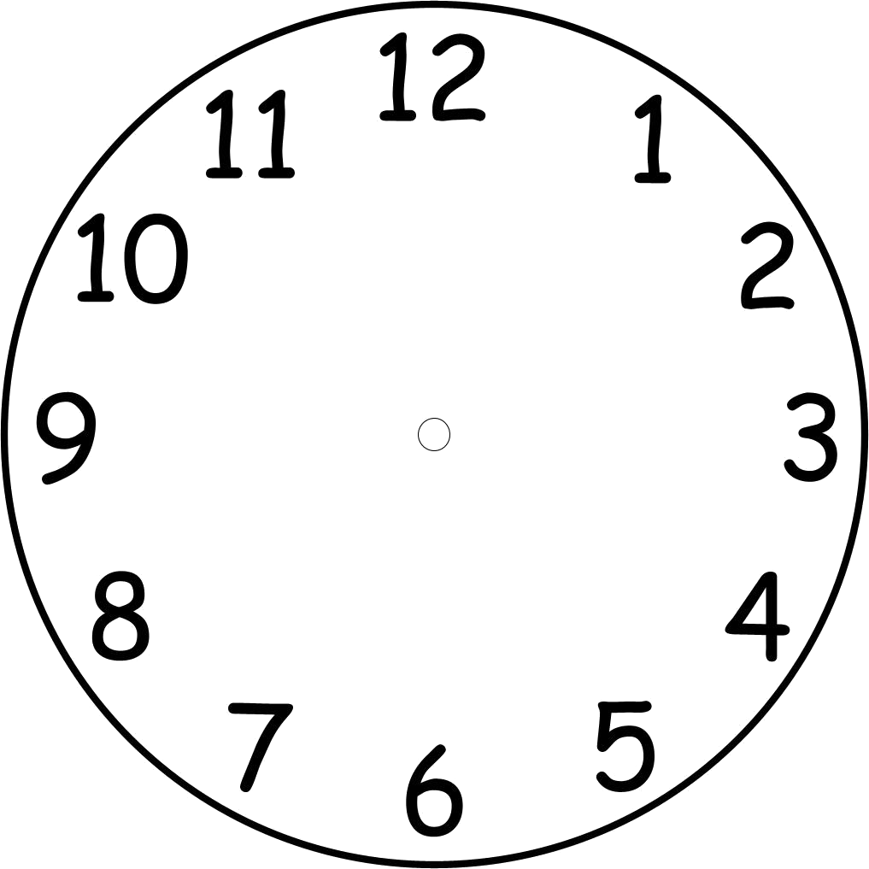
Group Activation
Personal Motivation
You contributed 12% less than other contributors this week
You contributed for less than 40 hours to the Mini-Grid this week
2x
Notes:
The second GridOrbit component was a notification system, and is aimed at increasing the commitment of existing contributors.
[CLICK]
The system is a desktop application that shows notifications about the user’s contribution level at different intervals.
These notifications follow two different motivation strategies.
[CLICK]
The ”group motivation” strategy aims at motivating the user to contribute more than the rest of the group, by comparing his contribution with the other participants.
[CLICK]
The ”personal motivation” strategy aims at motivating the user to contribute more, by comparing his contribution with their own the previous records.
[CLICK]
Finally, the notifications are configured to come up at different time intervals, from every 20 minutes to every 2 hours.

Slide 71
Evaluation
Part III
Notes:
Part III – Evaluation
In this part I will present how we study the GridOrbit systems in the wild, and the results from such deployment.

Slide 72
Agenda
Part I – Introduction
Part II – Design
Part III – Evaluation
Study Setup
Quantitative Results
Usage Patterns
Adoption Impact
GridOrbit Usage
Interviews
Part IV – Discussion

Slide 73
1- See what the impact of these awarness technologies is in the recruitment of volunteers.
1- See what the impact of these awarness technologies is in the recruitment of volunteers.
2- Gather empirical information about the relation of users and these awareness technologies.
2- Gather empirical information about the relation of users and these awareness technologies.
[Evaluation Study – Page 116]
Notes:
For this study, we declared two general goals in relation to the GridOrbit systems:
- First, to see how these awareness technologies impact the recruitment of volunteers to the Mini-Grid.
- And second, to gather emperical information about how users relate to these awareness technologies.

Slide 74
BASELINE
NOTIFICATION SYSTEM
Public Displays Novelty Factor
PUBLIC DISPLAYS
Mini-Grid
Baseline Computers
Official Start
Notes:
The study required to have a running Mini-Grid for which we configured a set of baseline computers, in order to guarrantee a minimal capacity.
[CLICK]
We also introduced the public displays (without gridorbit) for some weeks before the deployment in order to reduce novelty effect.
[CLICK]
We officially started the evaluation by inviting people to participate to the Mini-Grid in the way you would normally do in an organization:
we attended group meetings, had posters, flyers, and even posted static messages in the public displays.
This was our baseline condition.
[CLICK]
We then introduced GridOrbit in the public displays.
[CLICK]
And later on we started the notification system.

Slide 75
Jun 2
Wed
Jun 14
Mon
Jun 21
Fri
Jul 2
Fri
BASELINE
NOTIFICATION SYSTEM
Public Displays Novelty Factor
PUBLIC DISPLAYS
Mini-Grid
Baseline Computers
Official Start

Slide 76
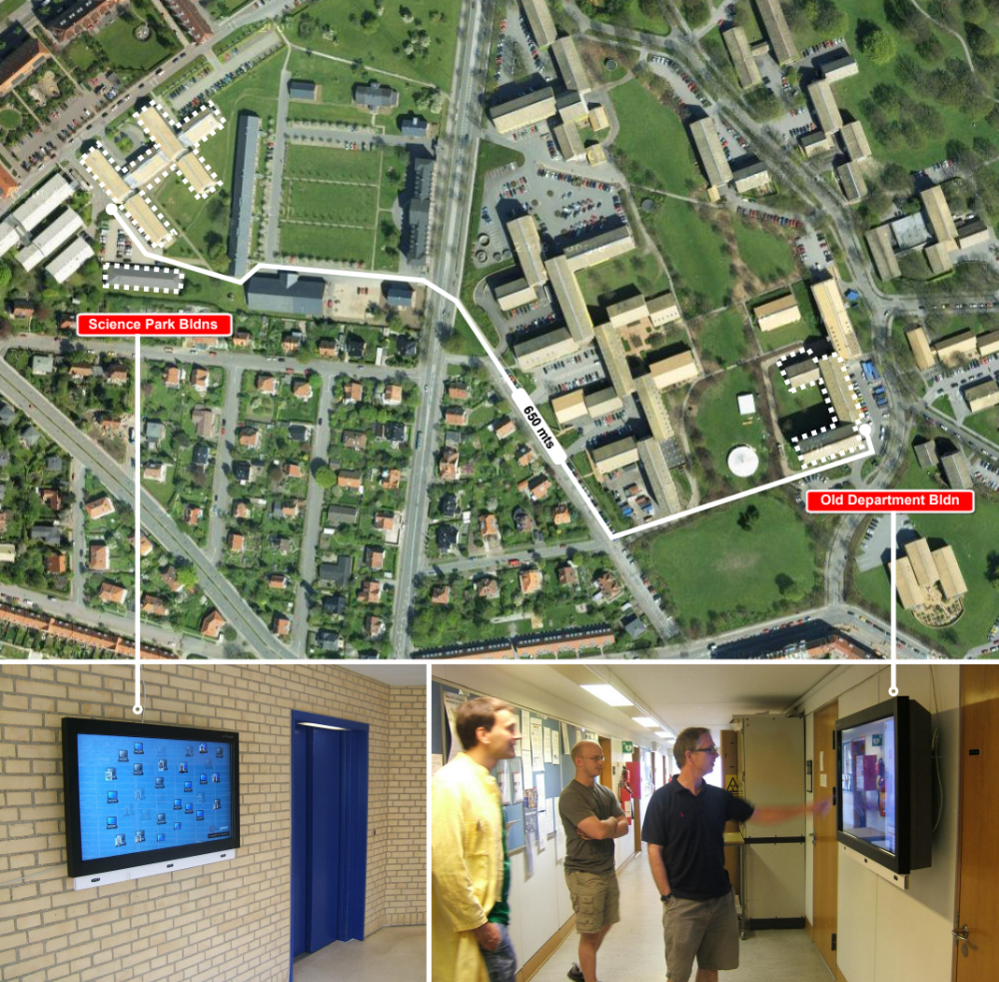
Notes:
As I presented before the public displays were located in two different buildings in campus, where the biology department functions.
These two buildings are separated some 650 meters.

Slide 77
machines
Mini-Grid tasks
visits and interactions
GridOrbit notifications
interviews
Notes:
Throughout the deployment we collected data in relation to:
Machines connected to the Mini-Grid every 30 seconds.
Mini-Grid tasks submitted and executed.
Visits and interactions with GridOrbit public displays.
User responses to the GridOrbit notifications.
Semi-structure interviews in relation to GridOrbit public display and notification system, and awareness of the Mini-Grid.

Slide 78
35
8
103
7264
5022
592
14
54
8
44
14
participant machines contributed at least once
machines submitted tasks
task batches
individual tasks
visits to the public displays
involved some kind of interaction
on-screen messages
pictured assigned to machines
users for the notification system (N.S.)
state queries
launches of the Mini-Grid client form the N.S.
[Descriptive Account of the Deployment – Page 119]
Notes:
In general numbers, we can say that we observed a total of…
OK, but what do these numbers tell us... let’s see.

Slide 79
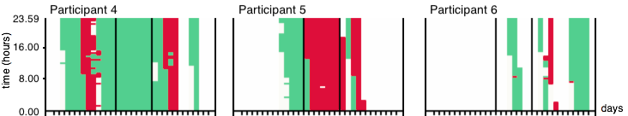
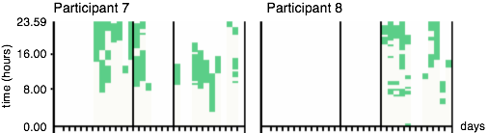
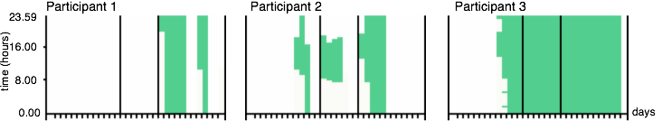
  Dedicated Secondary Computers
  Work Desktops
  Laptops (intermittent use)
  Bootstrapping Computers
[Contribution Patterns – Page 120]
Notes:
First, we looked at how machines contribute to the MiniGrid.
Each of these boxes represents a participant machines during the whole deployment period, and each column shows the contribution pattern in a day.
The green periods show when the machine was contributing,
the red periods show when the machine was turned on but not contributing, and
the white periods show when the machine was turned-off.
This first group of machines shows how dedicated and bootstrapping machines contribute. Basically, they stay for long periods of time and often day-round.
[CLICK]
The second group is made of work desktop computers. These machines also tended to stay connected for long periods of time, however, they were sometimes unplugged from the MiniGrid because the owner had to do some special work that required all of its power.
[CLICK]
Finally, we saw laptop computers contribute very intermitently.

Slide 80
+133%
35
Mini-Grid installed
15
+51%
AVG Computers
Contributing
8,02
5,33
Notification System
Baseline
Public Displays
[Adoption Impact – Page 121]
Notes:
The second thing we looked at was the number of machines where MiniGrid got installed.
The blue line shows that at the end of the baseline period, we reached the number of 15 machines. This machines were enrolled with traditional means like people talking to each other, presentations about the project, flyers, etc.
[CLICK]
After we introduced GridOrbit we observed an increment to a total of 35 machines, which means a 133% increment.
[CLICK]
However, all these machines are not always online at the same time.
So, we looked at the hourly averague number of machines connected, this number represents the actual capacity of the MiniGrid.
In this case we observe that during the baseline period we had an hourly averague of about 5.33 machines, out of 15 computers where the MiniGrid was installed.
[CLICK]
After introducing GridOrbit, we saw this average increase to 8,02 machines representing a 51% increment.

Slide 81
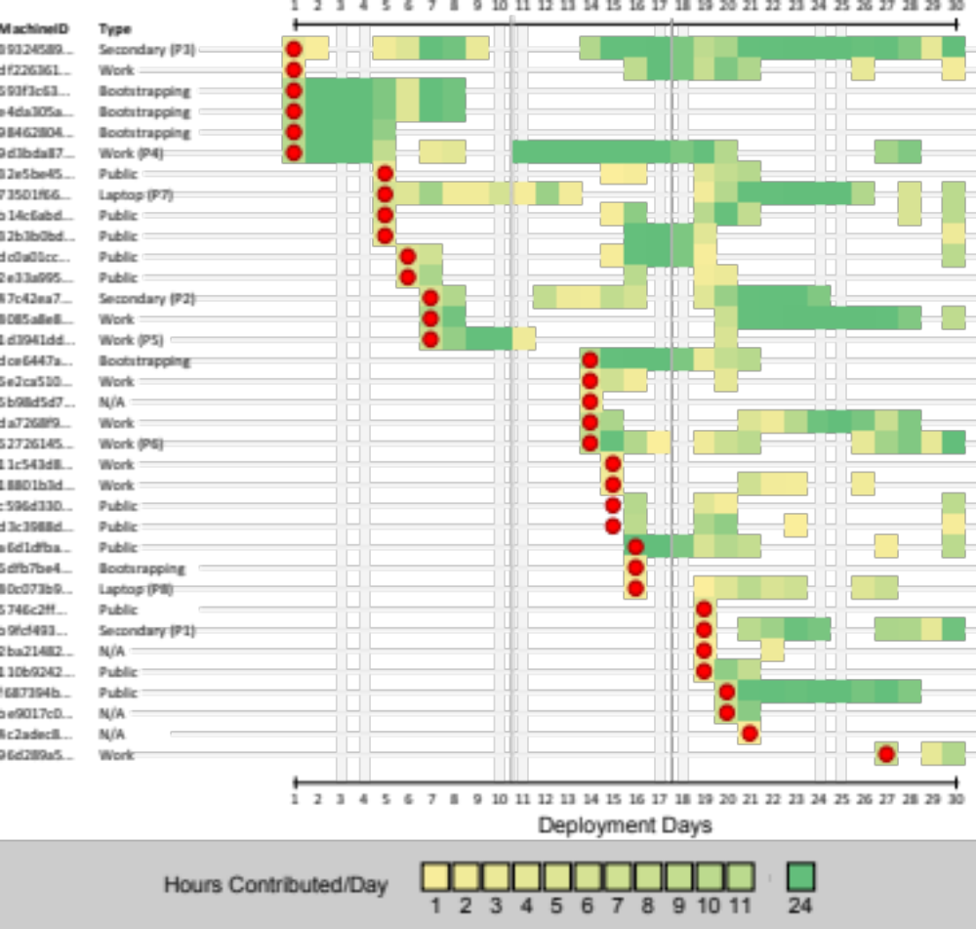
[Participants’ Contribution to the Mini-Grid – Page 123]
Notes:
This image shows a different perspective on the participant machines, showing how in many cases machines would be configured to participate and would later abandon.
The graph also shows how some machines tend to contribute for extended periods of time that stretch for days at times.

Slide 82
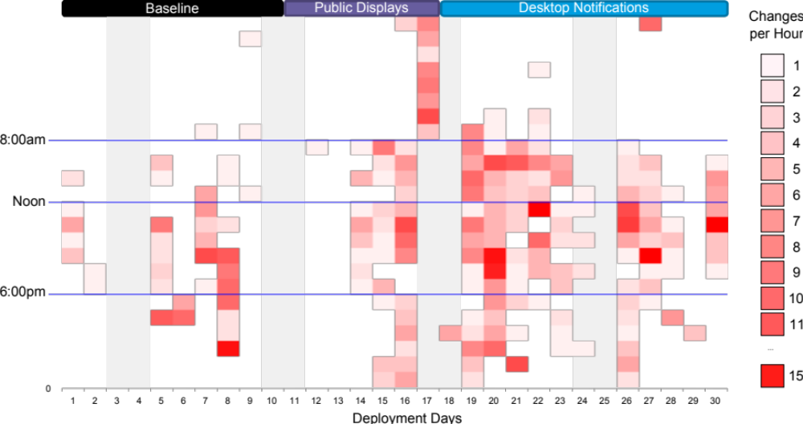
[Number of changes (join/leave) per hour – Page 123]
Notes:
So far, results have shown an increase in the current capacity of the Mini-Grid, that is, on the average number of participants at a given time.
We also looked at the number of changes of state per machine per hour.
Changes between contributing and not contributing relate to the stability and robustness of the Mini-Grid.
A visual scanning of the changes shows that there were more changes as the number of participants increased.

Slide 83
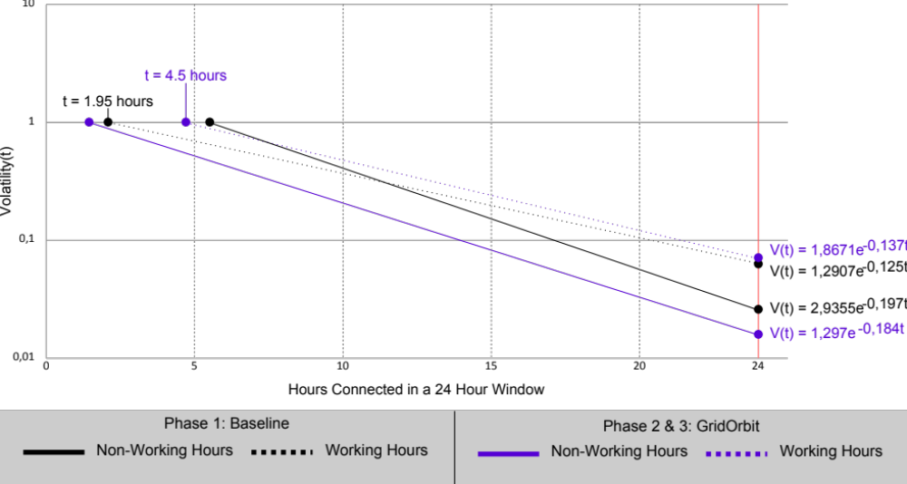
[Mini-Grid volatility in relation to participants – Page 124]
Notes:
To understand better the impact of this changing environment I looked into the volatility of the Mini-Grid.
The volatility is the probability that any machine will change it’s status as a function of the hours that it has been contributing.
The flat-lines show the volatility during non-working hours.
The dotted-lines show the volatility during working hours.
The graph shows that with the increase of participants any machine contributing for less than 4.5 hours during working hours would almost certainly drop out.
While this time was just 2 hours with less participants.
At the same time, the volatility during non-working hours was much lower when there were more participants.
This is an important finding because it suggests that users of the Mini-Grid would have a more stable system if they use infrastructure awareness systems to recruit more participants,
and if they submit jobs after hours.

Slide 84
Aware
60% of the Visits
Ambient Zone
Curious
30% of the Visits
Int + Notification Zone
- Touch Interaction
Explorer
10% of the Visits
Interaction Zone
+ Touch Interaction
[Δt = 1500ms – GridOrbit public display visitors – Page 125]
Notes:
We also analized the way users visited the public displays, and we found a consistent pattern across days and locations.
And we found that in a given day, 60% of the visitors would stay in the AmbientZone – and we call them ”aware visitors”.
30% would come either into the interaction or notification zone, but not engage with the displays – and we call them ”curious visitors”.
And 10% would come all the way to the display and touch it and explore the information – we call them ”explorer visitors”.

Slide 85
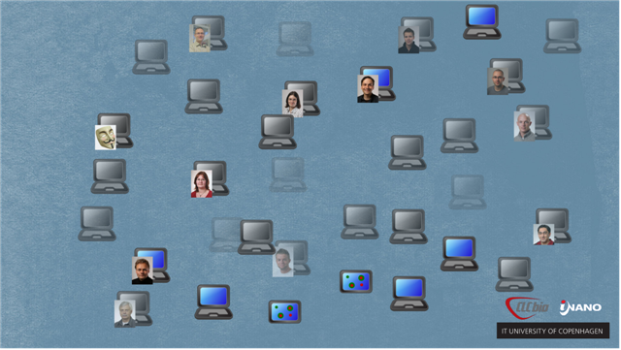
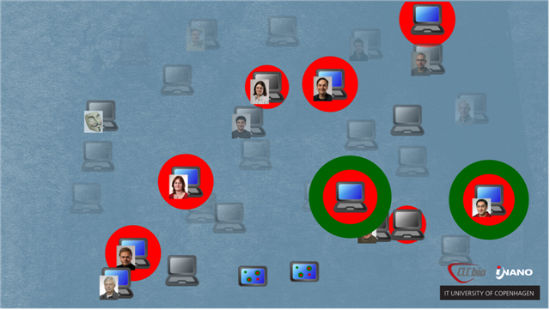
Visits to the Public Displays
-
+
Capacity
Activity
[Awareness Stagnation – Page 127]
Notes:
We also saw that the kind of information we showed in the displays had an effect in the number of visitors.
So, everytime GridOrbit showed increased actitivy levels, there would be more aware, curious, and explorer visitors.
However, everytime the screen started to get cluttered with a lot of machines, showing an increased capacity, there would be less visitors of all three types.
This is a phenomenon I call awareness stagnation, which means that the more participants GridOrbit attracked, the less efficient it was in attracting them.

Slide 86
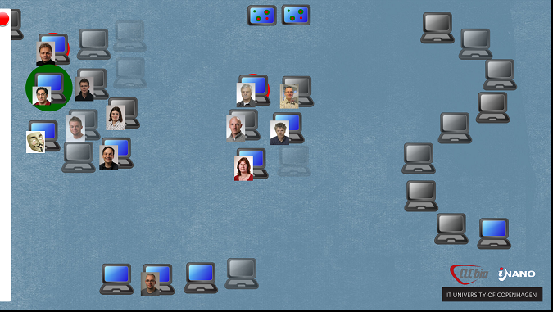
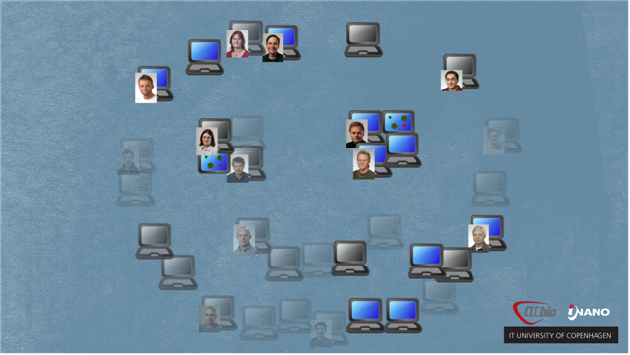
[Playfulness – Page 126]
Notes:
We also observed users engaged in a playful manner with the visualization, arranging icons in multiple ways.

Slide 87
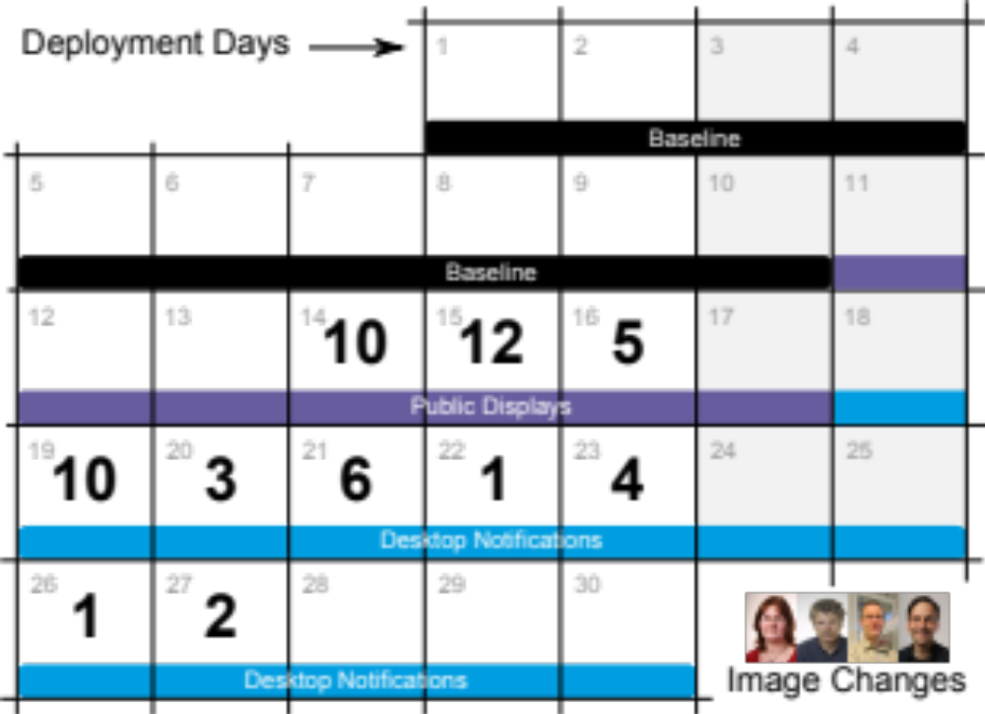
Notes:
The assignation of images was also well received, with users putting themselves up on the screen right after configuring their machines.

Slide 88
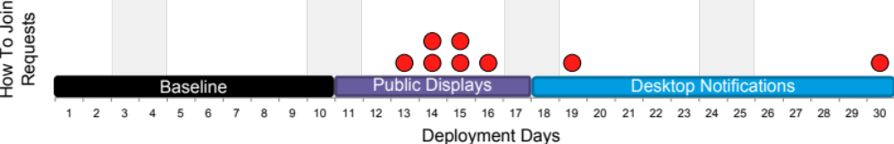
[How to Join requests from the public display – Page 128]
Notes:
Finally, GridOrbit succeeded in channeling requests from users that wanted to start participating and needed some help.

Slide 89
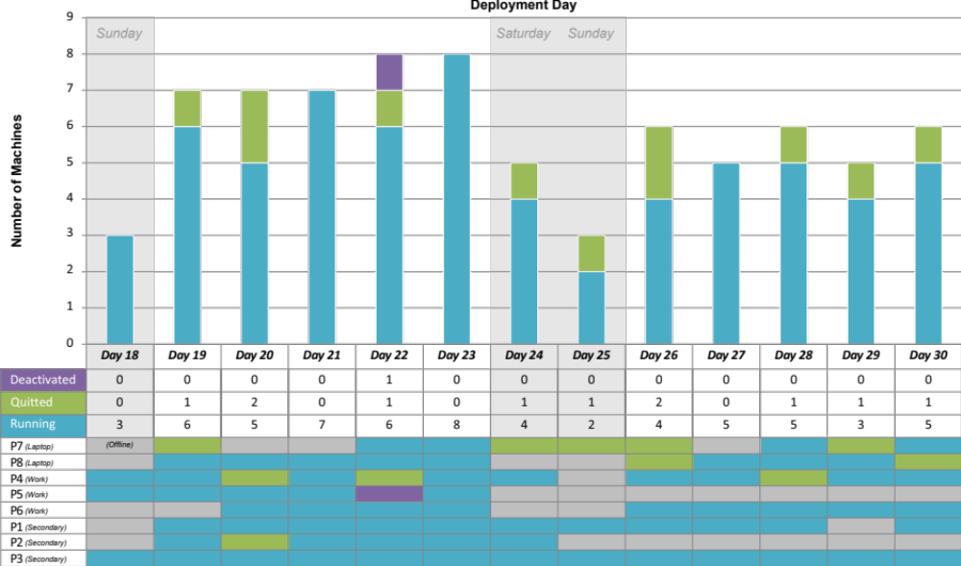
[Running status of the GridOrbit notification system – Page 128]
Notes:
We also collected data on the usage of GridOrbit notification system, and let’s keep in mind that only 8 participants installed this particular application.
This figure shows that for some participants on everyday work computers the notifications were disturbing, and thus they totally closed the system.
Some others had a more measured reaction to the disturbances, deactivating or quitting the system only in a few occasions,
Finally, one of the working computers and all of the secondary computers did not seem to have any problems with the notifications.
Notifications can be disturbing, and it can be due to the motivational model or the interval between messages;
however, our data analysis did not reveal any significant difference between conditions (we had a very small sample).

Slide 90
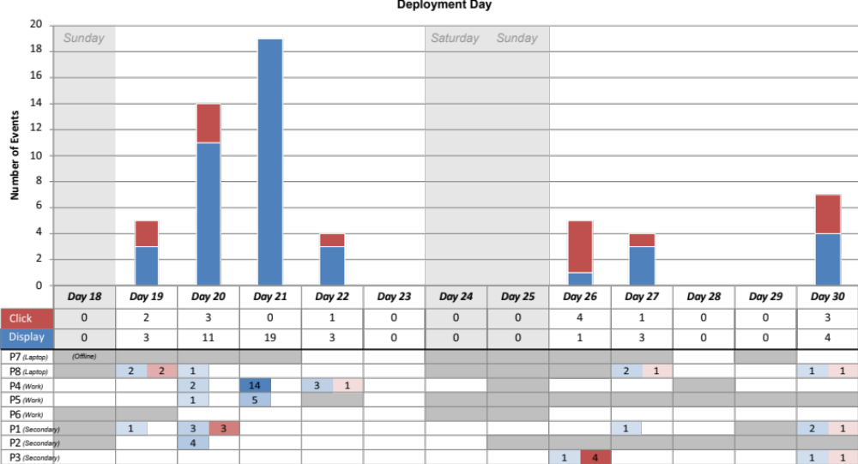
[Queries to, and launching of the Mini-Grid from, GridOrbit notification system – Page 129]
Notes:
This other graph shows the users’ interactions with the notification system.
Blue means requests for information.
Red means launching the Mini-Grid client from the notification system.
The figure shows an initial high number of requests across all machines.
This initial interest could be attributed to a novelty effect when users where first exposed to the notification messages.
However, the second week shows instances of sporadic requests from one laptop and two secondary machines.
The figure shows that users did indeed request information and click on the notifications, although not very often.
This could be because the automatic notifications alone maintained an awareness level good enough,
or because the Mini-Grid client application was actually running at the moment.

Slide 91
Necessity
Curiosity (limits, ease)
Enhancement
Reputation (recognition, visibility)
[Motivations to participate – Page 130]
Notes:
Moving to other results…
We carried out several interviews where we asked participants their motivations.
Some participants reported that they actually needed the Mini-Grid for running their computational tasks.
Some others declared that although they had other ways of executing computationally demanding tasks, they were curious as to what kind of power or ease of use the Mini-Grid could provide.
Other participants, however, were less interested in using the Mini-Grid and more into the social aspect of participating.
Some participants said that they felt good helping other researchers with their spare resources.
While others declared that it could be a way for them to increase their reputation and gain organizational visibility.

Slide 92
Face Time!
From: Participant X
Date: Wed, Jun 16, 2010 at 1:51 PM
Subject: Re: GridOrbit hide details 6/16/10
Hi Juan
I got the plugin installed and the whole thing should be up and running. Now I just need to figure out how I can get my picture on the screen in the main building... Do I need to set up some profile somewhere or something like that?
Cheers
Notes:
Finally, there are other results, which can be consulted in chapter 7 of the dissertation, but this one is particularly interesting:
People want to have their picture on the display, and they will do whatever to get it on.

Slide 93
The on-screen messaging functionality (bulleting board) was not used. We saw only 5 messages for the whole deployment.
We did not find any significant impact of the different notifications strategies.
Notes:
And we also had a few things that didn’t work quite as expected:
READ THE SLIDE!

Slide 94
Discussion
Part IV
Notes:
Part 4 – The Discussion
In this part I intend to reflect on the whole exploration, by looking at the different hypotheses implicit in our approach and designs,
and comparing them to the results we captured.
Then, I will present a couple of reflections: The first, about applying infrastructure awareness to volunteer computing.
And the second, about how I see infrastructure awareness play out in a world full of computational infrastructures.

Slide 95
Agenda
Part I – Introduction
Part II – Design
Part III – Evaluation
Part IV – Discussion
Hypotheses
Hypothesis Analysis
Volunteer Computing Case
A World of Infrastructures
Conclusions

Slide 96
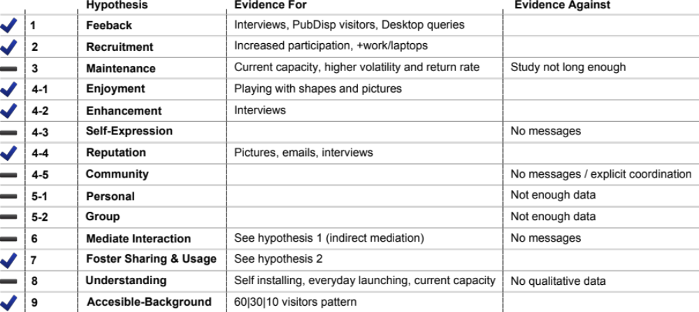
[Analysis of Hypothesis – Page 131]

Slide 97


Hypothesis 1 Infrastructure awareness systems can provide volunteer computing participants with feedback on their contributions.
Hypothesis 2 Infrastructure awareness systems can foster the recruitment of participants to volunteer computing.
Hypothesis 3 Infrastructure awareness systems can help maintain the enrollment of existing participants to volunteer computing.
[as feedback mechanisms for volunteer computing]
Notes:
The first set of hypotheses at the feedback level – and refer to whether the GridOrbit systems actually succeeded in providing feedback on the Mini-Grid usage.
The first one: infrastructure awareness… feedback
[CLICK] Well it all looks like they did: we had a constant flow of visitors to the public displays in the identified proportions, and we saw how users consulted the notification system. Moreover, users referred to the auras on the display during the interviews, when they explained their behaviours.
The second one: infrastructure awareness… recruitment
[CLICK] This hypothesis also seems confirmed because not only there was an increased number of participants after we introduced the GridOrbit systems, but also this participants were work and laptop computers; meaning that they were actual new people.
The third one: infrastructure awareness… maintenance
[CLICK] The deployment showed a steady level for current capacity. Given the relative short time of our deployment, one month, we cannot really say much about abandonment or maintenance of participants.

Slide 98
Hypothesis 4 .1 The enjoyment level induced by the infrastructure awareness representation is associated with participation.
Hypothesis 4 .2 The enhancement level induced by the infrastructure awareness representation is associated with participation.
Hypothesis 4 .3 The possibility of self expression through the infrastructure awareness systems is associated with participation.
Hypothesis 4 .4 The possibility of increase the participant’s reputation through the infrastructure awareness system is associated with participation.
Hypothesis 4 .5 The possibility to join a community through the infrastructure awareness systems is associated with participation.
[GridOrbit public displays – as support for participants’ motivations]
Notes:
Also at the feedback level, a second set of hypotheses relates to the success of the motivational triggers embedded in the design of the public displays.
4.1 associates enjoyment with participation
[CLICK] We saw some instances of enjoyment like when participants engaged playfully (shapes and pictures) with the displays, increasing their visual appeal;
which as we saw in the awareness stagnation discussion, visual appeal attracts more visitors to the displays.
4.2 and 4.4 associates enhancement and reputation with participation
[CLICK] Well this one is easy because users themselves reported enhancement as one of their main motivations, and because participants actually bothered to associate their picture with the actual machines they contributed.
4.3 associates participation with the possibility of self-expression, while 4.5 with the possibility to join a community.
[CLICK] Our data did not show any significant engagement with the messaging functionality. On one-month, there where only 14 messages posted and some of them where simply testing.
Nonetheless, a community might have been formed out of the reach of the GridOrbit system, but we did not collect data reflecting that.

Slide 99
Hypothesis 5 .1 Comparing one’s performance to personal historical records positively impacts contributions to volunteer computing.
Hypothesis 5 .2 Comparing one’s performance with the group performance positively impacts contributions to volunteer computing.
[GridOrbit notification s. – as support for participants’ motivations]
Notes:
A final set of hypotheses at the feedback level relates to the success of the motivational triggers embedded in the design of the notification system.
5.1 associates comparing with one’s personal historical records with higher participation, while 5.2 associates comparing one’s performance with that of the group.
Unfortunately, for neither hypotheses we managed to collect data enough to say anything. They remain unanswered questions.

Slide 100
Hypothesis 6 Infrastructure awareness systems mediate the interactions between the members of the resource-centric informal human infrastructures formed around the volunteer computing infrastructure.
Hypothesis 7 Infrastructure awareness systems foster the sharing of resources to, and the usage of, a volunteer computing infrastructure.
[as support for resource sharing]
Notes:
The second kind of hypotheses relates to the role of the GridOrbit systems to mediate the sharing of resources.’
Hypothesis 6 claims that infrastructure awareness systems mediate…
Our data did not show any evidence of GridOrbit mediating the interactions between users; it could have happened in a subtle way, derived from the awareness users have, but not in a way that could be capture.
Hypothesis 7 claims that infrastructure awareness systems foster…
Similar to hypothesis 2, resource-sharing is validated through the increased number of participants after introducing the awareness systems.

Slide 101
Hypothesis 8 Infrastructure awareness systems provide users with an understanding of the volunteer computing infrastructure, supporting the formation of correct mental models of it.
Hypothesis 9 Infrastructure awareness systems can make volunteer computing accessible in the background.
[as an infrastructure awareness system]
Notes:
The final kind of hypothesis relates to the effectiveness of the GridOrbit systems in providing an infrastructure awareness.
Hypothesis 8 says that: infrastructure awareness systems provide… understanding and mental models
Unfortunately the verification of mental models and understanding is beyond the tools I am familiar with, therefore I cannot really say much about it.
Hypothesis 9 says that: infrastructure awareness systems can… accessible in the background
Our data indicated we achieved such accessibility in the background (which is the moving between a low level ). First, with the consistent pattern of visitors to the public display 60|30|10.
And also, to a lesser degree, users kept consulting the notification system.

Slide 102
Infrastructure Awareness for V.C.
What we’ve seen:
Study Implications:
Infrastructure Awareness
Design Space for V.C.
Iterative Design Process
Awareness Model
Motivational Model
Local and Symmetric
→ Existing community
→ Solidarity and duty
→ Social dynamics
→ Leverage existing sharing practices
Metaphor-guided Design
→ Awareness model
→ Motivational model
→ Motivation Techniques
Notes:
OK, I will finish my presentation with two reflections:
The first one relates to the role of infrastructure awareness systems when supporting the recruitment of volunteer computing participants.

Slide 103

A World of Infrastructures
The prevalence of the duality user / non-user
Digital Housekeeping
Infrastructure Awareness with multiple detailed visualizations:
  Seamful design → Troubleshooting and Workarounds
  Intelligibility → Understanding, learning and control
  Dashboard → Diagnosis

Slide 104




Thank you!
Ebbe, Zsuzsanna, Reeza, Morten, Jørgen
Jakob, Aurelien, Sokoler, Neela, Tinus & Dinesh
Morten, Bjarne
[I am happy to answer questions]

