Slide 1
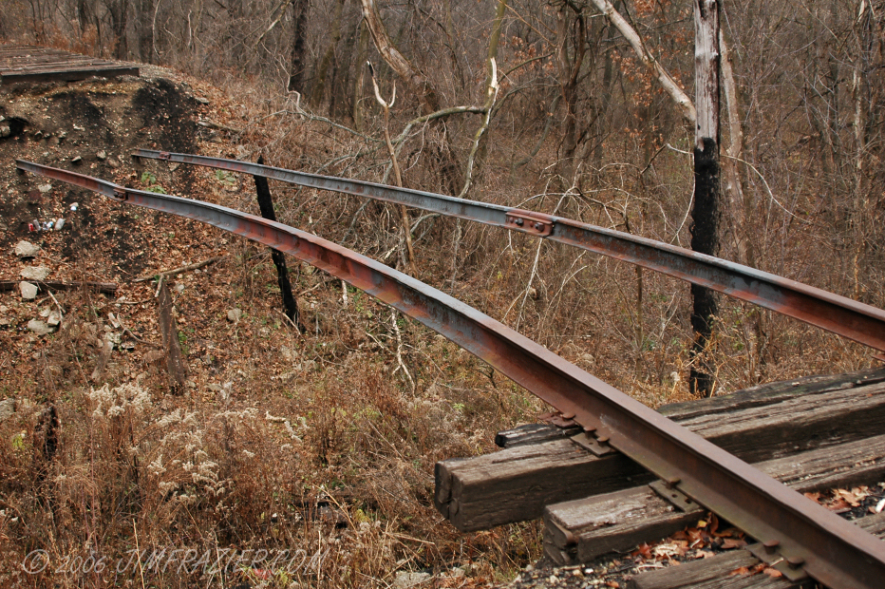

Infrastructure Awareness
Supporting the Adoption of
Voluntary Computing Infrastructures
jdhr@itu.dk - @jhincapie
Juan David Hincapié Ramos
DC Ubicomp 2010 – September 26, 2010
Notes:
Good morning,
This presentation is a first attempt for the presentation I plan to give at the Doctorall Colloquium during Ubicomp 2010.
The goal is to cover the overall of the research leading to my dissertation, so I purposely leave out a lot of details, however feel free to ask and we can go deeper into the topics you like.

Slide 2

Mini-Grid (local volunteer computing)
2
Notes:
Before I present my research, we need to get familiar with the background of our work.
In our group, we are building a Mini-Grid.
A Mini-Grid is a dristibuted volunteer computing infrastructure where users voluntarily donate computing power to execute everyone’s tasks.
[CLICK]
So, tasks that were previously executed in a single machine are broken down into pieces and distributed among the Mini-Grid members.
[CLICK]
As more computers join the minigrid, its capacity increases, and there are gains in robustness and stability.
However the Mini-Grid is a software framework embedded in a molecular biology software suite, and runs the background of people’s machines.
The Mini-Grid cannot be seem, it’s invisible.

Slide 3
Participation
Notes:
The general area of my research is the issues related to the participation of contributors for this kind of local volunteer computing infrastrucutres.

Slide 4

Leaderboards
Community Website
Team Formation
Reward System

Slide 5
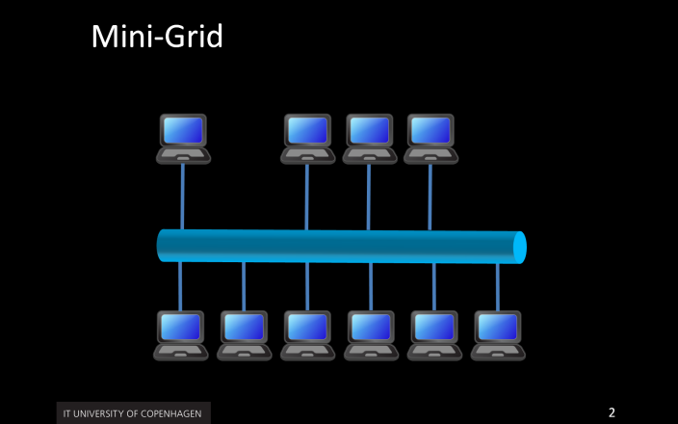
Invisibility of Infrastructures
… invisibility hinders trust and adoption, by keeping users from forming correct mental models of infrastructures.
[Poole08, Poole09]
3
Notes:
We study participation from the standpoint of the invisibility of the infrastructure.
This invisibility brings problems in terms of trust and adoption.
In the case of the Mini-Grid, lack of adoption would affect its capacity, as it depends on donors for its functioning.
To counter this problems, researchers have looked into solutions like infrastructure visualizations, seamful design, and intelligibility.
We are working on another alternative called Infrastructure Awareness.

Slide 6
Infrastructure Awareness
is a feedback mechanism on properties of technological infrastructures provided in the periphery of user’s attention.
Infrastructure Awareness Systems aim at conveying this information in the periphery of users’ attention by means of ambient technologies.
4
Notes:
I define Infrastructure Awareness as a feedback mechanism on properties of technological infrastructures provided in the periphery of user’s attention.
Infrastructure Awareness systems then, convey information about an otherwise invisible infrastructure to the users, in the periphery of their attention by means of ambient technologies.

Slide 7
How does infrastructure awareness technologies affect the adoption of local computing infrastructures
How do users related to such infrastructure awareness technologies

Slide 8
Related Work
Awareness
Systems
Infrastructure Invisibility
Volunteer Computing Adoption
Infrastructure Awareness
Intelligibility
Seamful design
Visualizations
SETI@Home
World Community Grid
5
Notes:
This research takes elements from different areas of HCI and Ubicomp.
[CLICK]
Under the umbrella of ”Infrastructure Invisibility” we find ubicomp efforts to counter the problems of invisibility like intelligibility, seamful design, and some visualizations.
We also take into account the experiences in building traditional awareness systems.
[CLICK]
And finally we pose a different alternative to existing ways of engaging people in grid infrastructures, like the ones posed by Seti@Home or the World Community Grid.

Slide 9
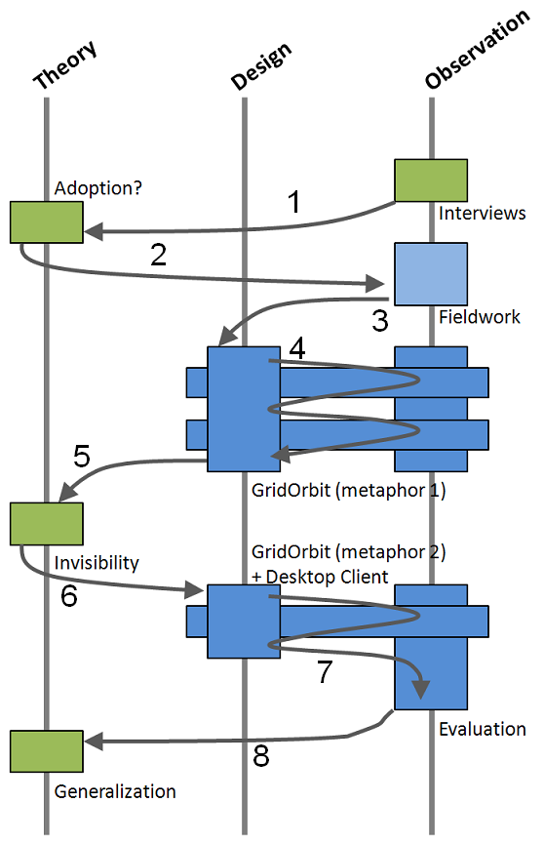
Research Approach
Nascent Theory
Exploratory Research Approach
Triangulation Process
6
Notes:
This investigation is by no means conclusive and comprenhesive in the topic.
Rather, it aligns to a nascent theory situation.
A nascent theory is the result of explorations into a field of knowledge.
[CLICK]
This explorations are based on intervention and reflection, as afforded by the triangulation process we have followed.

Slide 10
Contributions
Methodological
AM Cards Technique
Technological
GridOrbit-pub
GridOrbit-per
Conceptual
Awareness Model
Design Space
7
Notes:
Now, so far into the research I am able to identify some of the contributions of this work.
The contributions align to the different levels of the triangulation process: conceptual, metohdological and technological.
So, at the conceptual level we study the theoretical foundations for infrastructure awareness, we developed an awareness model in terms of nimbus and focus, and finally look into a possible design space.
At the methodological level we developed a card matching participatory design technique, to counter the problems brought about in the design by the infrastructure being invisible.
And at the technological level we, so far, have designed and deployed two infrastructure awareness systems GridOrbit and GridNotify, which in themselves are contributions as PoC.

Slide 11
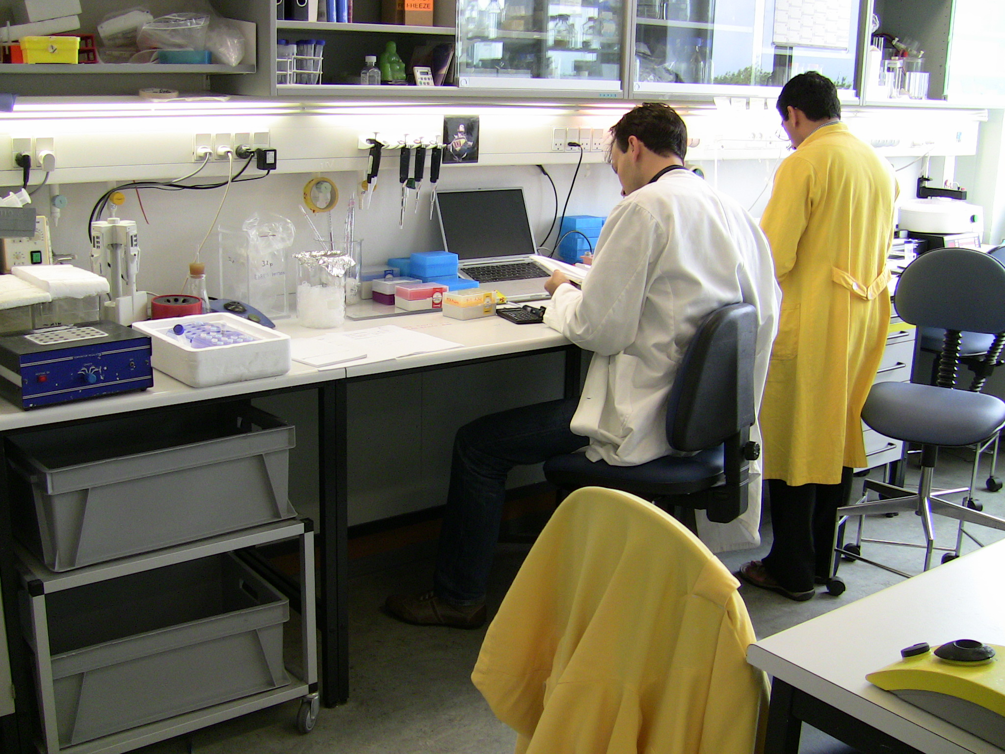
Implications for Design
Sharing and Awareness
Public and Personal Spaces
Awareness Cues
8
Notes:
In exploring solutions for the recruitment of contributors to the Mini-Grid, we performed fieldwork and participatory design:
+ Confirmation that awareness plays an important role in sharing
+ Led us to design technologies for both the public and personal displays
+ Define the things of the Mini-Grid that users would be interested in ← so that they would trigger their participation

Slide 12
Awareness Cues
{
Activity Level
Capacity
Computers and People

Slide 13
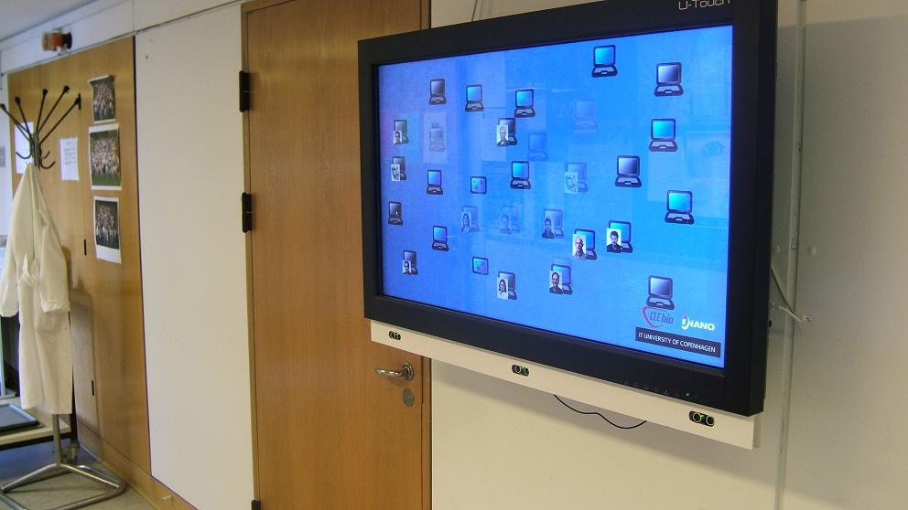
GridOrbit public display
Hincapie-Ramos et al. – CHI’10 EA WiP
9

Slide 14
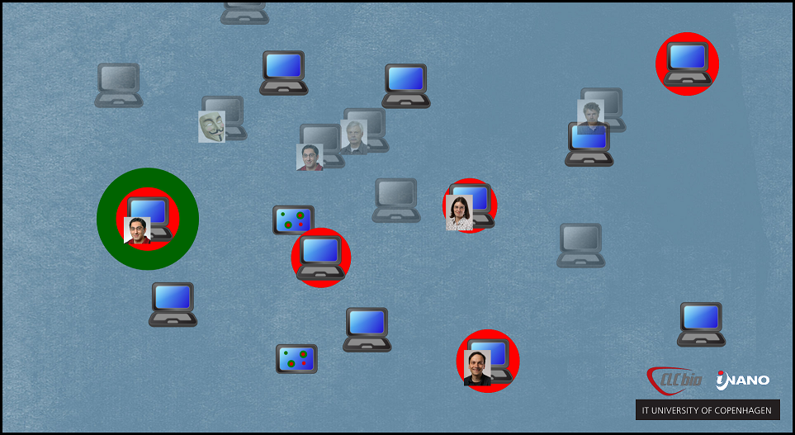
5
10

Slide 15
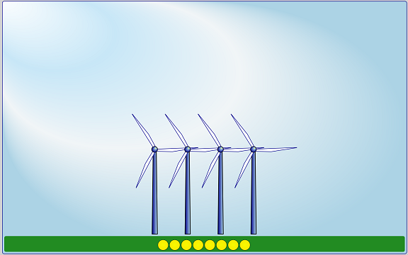
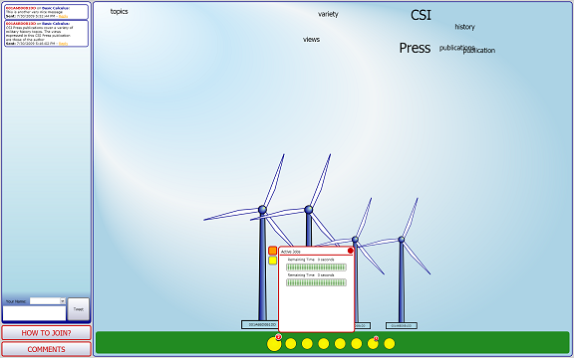
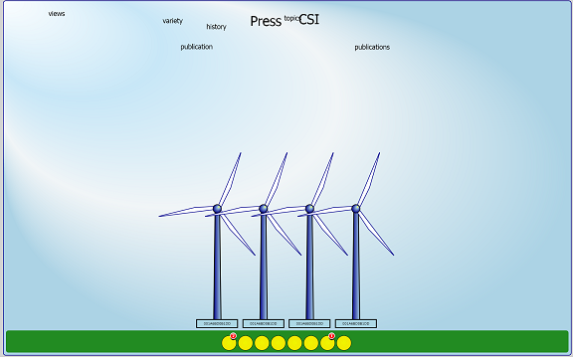

11
Notes:
GridOrbit is a tool to provide grid awareness through a set of public ambient displays. In designing gridorbit we used a set of metaphors (like windmills and lightbulbs in version 1) to translate the inner workings of the grid to things of potential interest for the biologists. We also added different interaction modes so that users can access more detailed information as they come closer to the displays.

Slide 16
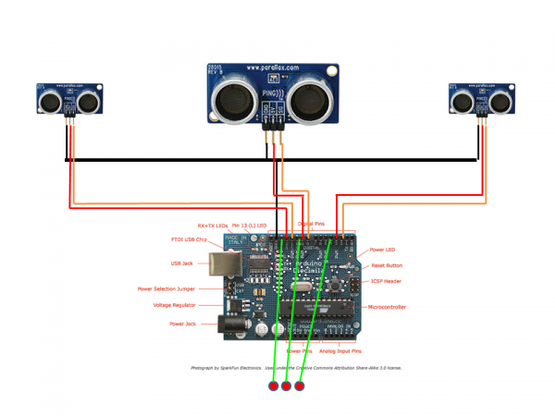
12

Slide 17
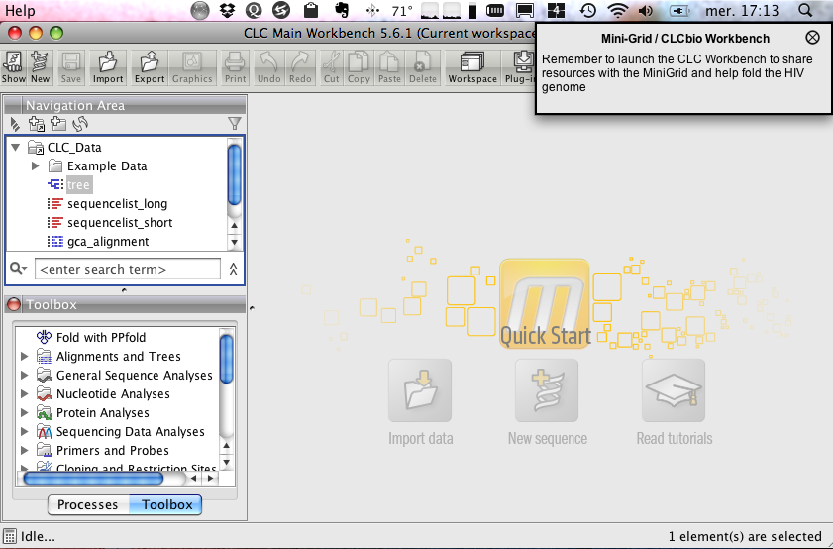
GridOrbit notification system
Desktop application that pops up messages once in a while.
13

Slide 18
Motivational Strategies
Personal
“You contributed for less than XX hour(s) to the Mini-Grid this week”
Norm-Activation
“ You contributed ZZ% less than other contributors this week”
14

Slide 19

Field deployment
30 days
Open participation

Slide 20
Deployment Results
Impact of Awareness
  Increase in Participants
  Participants Motives
  Participants Behavior
User Relation with the Awareness System
  60—30—10
  Capacity -vs- Activity
15

Slide 21
75% increase in potential capacity
51% increase in actual capacity
16

Slide 22
Explorer 10%
Curious 30%
Aware 60%
17

Slide 23
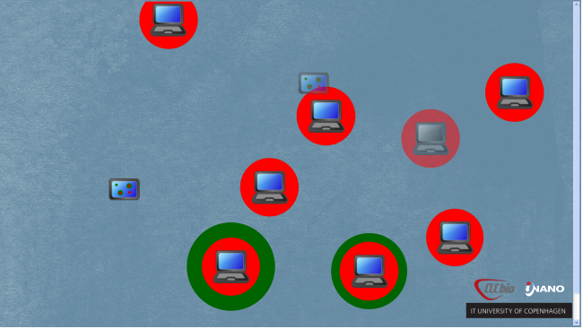
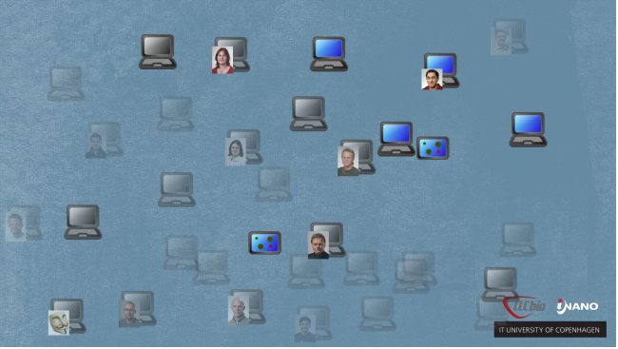
+
-
Activity
Capacity
Notes:
+

Slide 24
Foundations
Hermeneutics and Phenomenology
Different than the ”natural awareness”
Present-at-Hand approach
  Requires the user’s attention and is appropriate for learning, discovery and breakdown.
  Prior efforts align to this approach.
Ready-to-Hand approach
  Providing infrastructures with the required feedback for long term engagements.
23

Slide 25
Awareness Model
Application of the Benford and Fallen’s spatial model of awareness to the domain of infrastructures and adoption.
A different perspective on awareness where the entities are not embedded in the system, but rather the system itself is an entity.
24

Slide 26
O
Nimbus
What the entity projects about itself
Focus:
What the entity is interested in
25
Notes:
According to the spatial model of awareness, an entity has interests (called focus) and projects things about itself (called nimbus).

Slide 27
A
A
B
26
Notes:
An object A is aware of object B when A’s focus meets B’s nimbus;
[CLICK]
that is, when A is interested and has access to what B projects about itself.

Slide 28
IA
U
I
27
Notes:
In the context of infrastructures and their users, infrastructures are invisible and users focus on completely different things.
[CLICK]
Infrastructure Awareness systems come into the picture to translate what the infrastructure projects into the interests of the users.
AND I ADDED THIS!

Slide 29
Design Space
Existing Dimensions
  Awareness of place versus awareness of people
  Precision
  Accuracy
  Notification level
  Input automation
  Private versus shared
  Level of user control
New dimensions
  Fidelity
  Coverage
  Motivation
28
Notes:
At the moment, I am constructing a literary review on awareness systems where I look at the focus of the work (HCI or IxD) and from there, it’s possible to abstract a series of concerns from the different areas.
This concerns define and sustain the implementation of a series of established dimensions for awareness systems.
Our empirical work building AIS has helped us identify three new dimensions: fidelity, coverage, and motivation.
These new dimensions respond to the needs of infrasrtucture awareness systems, and can be considered both from the HCI and IxD perspectives.
For ex

Slide 30
Design Space - Fidelity
Usage of visual metaphors for representing infrastructures.
29
Notes:
For example, fidelity relates to the use of visual metaphores for representing infrastrucutres.
Visual metaphors are convenient for two reasons: the complexity of the infrastructure and the role of the AIS as
ambient display.
The higher the fidelity of the visual representation, the less metaphorical it is.
However, there exist a relation between the metaphor fidelity and the user understanding. Well understood infrastructures can use low fidelity metaphors without jeopardizing the user understanding.

Slide 31
Design Reflections
{
Creating Awareness?
The Role of Metaphors
Hincapie-Ramos et al. – CHI’10 Workshop – Briging the Gap
18
Notes:
The methodological contribution of my research tries to answer to the question of how to design this kind of systems.
Reflecting on the design process for our awareness technoligies, we found problems on the definition of ”awareness”, and how the lack of a formal definition generated problems in designing such systems.

Slide 32
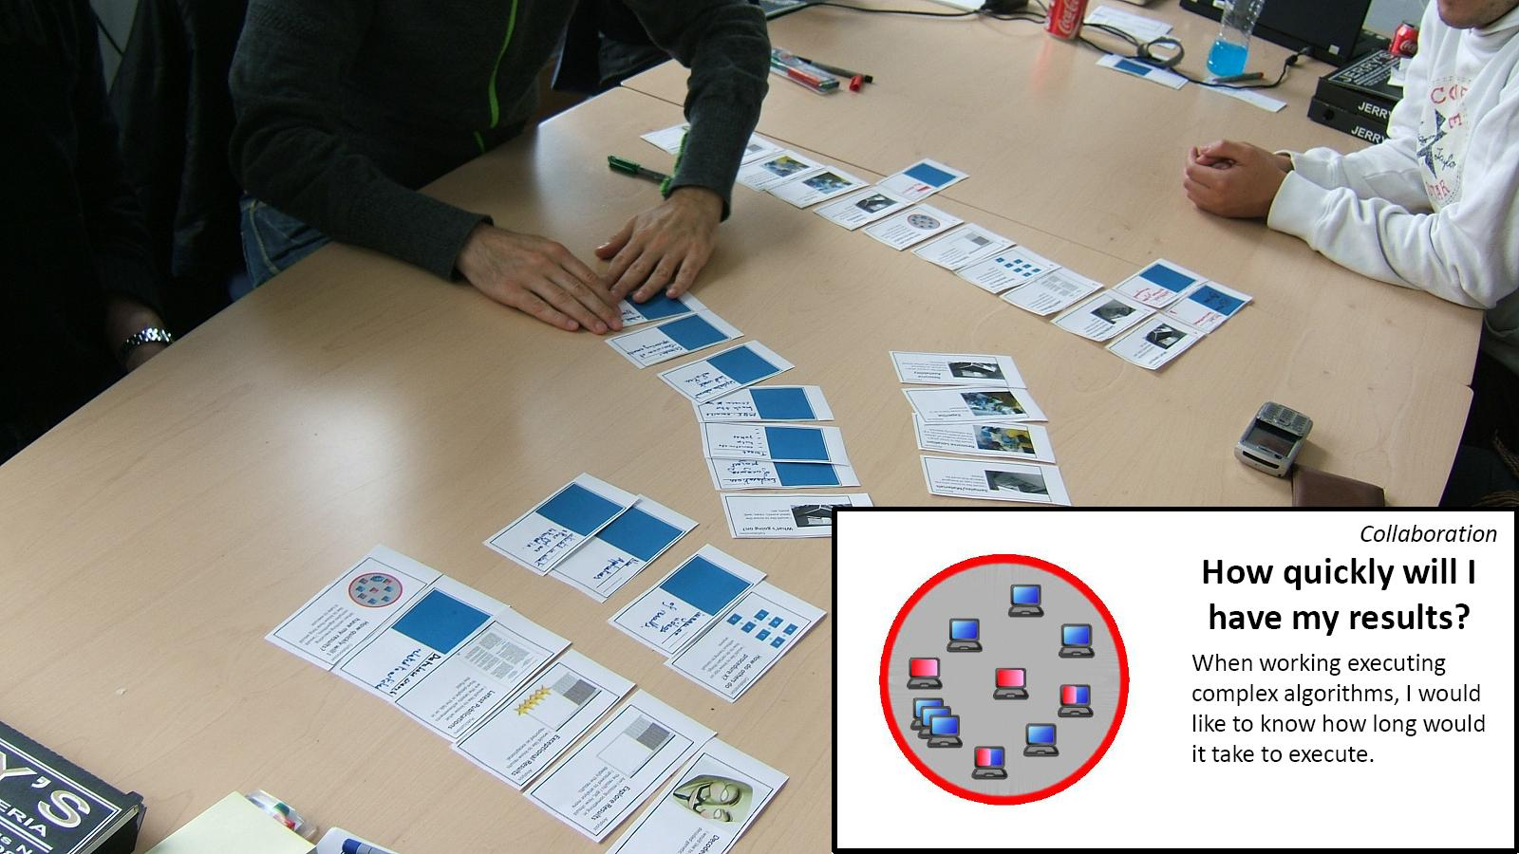
AM Cards Technique
Hincapie-Ramos et al. – DIS’10
19
Notes:
To answer this issue, we have design and developed the AMCard technique: a card matching technique for participatory design, which goal is to co-build the awareness model for the IAS.
It means to define the interestes of the users and the features of an IAS that match those interests and can thus provide the desired awareness.

Slide 33
Infrastructure Critique,
Implications for Redesign
User Focus Cards
Fieldwork
User Focus Cards
AMC Workshop
Design Concept
+ Closure
Infrastructure Awareness Prototype
Infrastructure
Nimbus Cards
The InfAwareness System
Infrastructure Awareness System’s Features
Technique Stages
Design
Presentation
Matching
Closure
20
Notes:
This is the overall flow of our technique.
Compared to the inspiration cards workshop, our technique is used later on in the design process, after the inspiration phase, so the process and the expected outcome are different.
It aims at narrowing down the design space, rather than opening it
[CLICK]
So, by now we already have domain knowledge, an infrastrufcture, and an initial infrastructure awareness solution.
[CLICK]
We use this three elements to generate focus and nimbus cards.
Nimbus cards differ from the technology cards of the inspiration cards technique, in that they are limited to the existing infrastruture and proposed solution.
As you can see in the upper loop, the process allows to refine what is already known about the users’ focus, by generating new focus cards.
It also creates opportunities to critique the infrastructure in regards to its adoptability.
[CLICK]
This flow can be roughly divided into four stages: design, presentation, matching and closure.
I will present the stages in the context of a AMCards workshop we conducted to improve our initial GridOrbit solution.

Slide 34
AMC – Closure
Matched
15 groups
  11 matches
  4 missed
13 cards discarted
  9 focus
  4 nimbus
The interests can be met
Missed
Either interests or
infrastructure are
insufficient
Discarded
Irrelevant for the
solution
21
Notes:
Final stage: closure
In this stage designers examing the produced groups of cards.
These groups can end up in three situations:
Matched: meaning that the users’ interests can be met with the existing solution.
Missing: meaning that either the infrastructure awareness system or the infrastructure can be improved to cover the users’ interests.
Discarted: representing useless functionalities, or impossible to fullfil user interests.
[CLICK]
In our workshop, participants created 11 match groups, 4 nimbus cards were discarded as irrelevant, 9 focus cards were discarted as not related, and 4 groups were classified as missed.

Slide 35
AMC Results
A
    To evaluate how relevant is the information displayed by infrastructure awareness systems.
    Relevant: machines and people associated to them
    No Relevant: the details of task distribution.
B
    To identify which of the users interests infrastructures awareness systems do not take into account.
    Algorithms, input data and parameters
C
    To identify elements of re-design in the infrastructures themselves so as to improve their adoptability.
    Task execution results (numeric or graphical)
22
Notes:
Details of specific results for the design and redesign of GridOrbit and the Mini-Grid can be found in the paper.
I would like to finish with a reflection on the technique.
The AMCard technique provides three benefits:
A: It helps to evaluate how relevant the information displayed by the infrastructure awareness system is.
CLICK
For instance, the participant machines and people associated to them were relevant, whereas the details of task distribution were not.
B: It identifies which of the users’ interests are not taken into account by the infrastructures awareness system.
CLICK
For instance, the details of executing tasks, like algorithm, input data, and parameters.
C: It identifies elements of re-design in the infrastructures themselves so as to improve their adoptability.
CLICK
For instance, the Mini-Grid does not publicly provide access to results of each task. This results could be in the form of numeric values or images.
Thanks!

Slide 36
How is it different from other Awareness Systems?
Infrastructure as the information source
Awareness model (explicit and non-contained)
Phenomenological perspective
  Peripherical Feedback
  Ready-at-hand & Present-to-hand
  Long term
  Transition Support
30

Slide 37
Future Work
New Iteration of GridOrbit
Short project on applying the same principle at email, interruptions and stress levels.

Slide 38
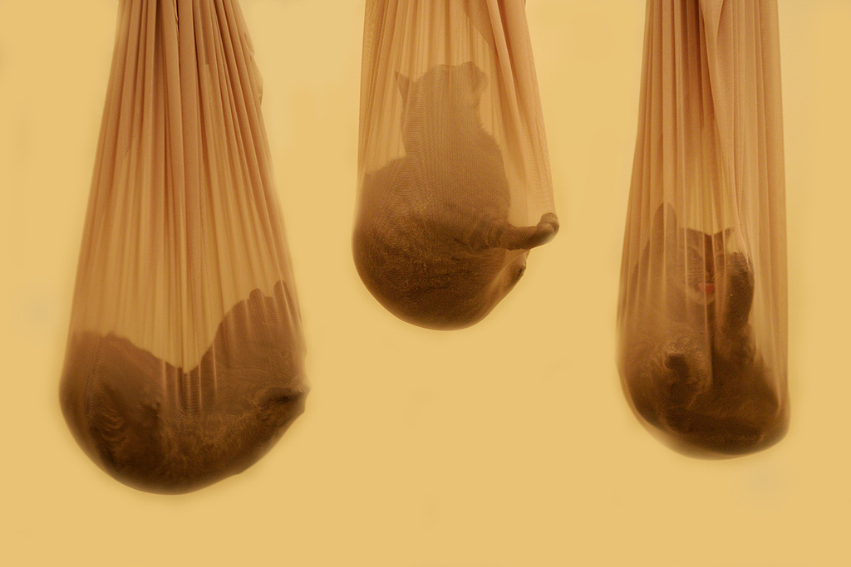
Designing for the Invisible - Techniques for User-Centered Design of Infrastructure Awareness Systems
DIS 2010.
Gridorbit public display: Providing grid awareness in a biology laboratory
CHI 2010 Poster
GridOrbit – An Awareness System Supporting the Adoption of a Volunteer Computing Infrastructure
CHI 2011 In Submission
Contextual-analysis for infrastructure awareness systems
CHI 2010 Workshop
Bridging the Gap
31
Notes:
The work carried out in my research has been presented at different stages.

Slide 39
How is this different from other data visualization?
Long term engagements
Peripherical feedback channel
Aimed at: activity, unexpected behavior, breakdown.
28

Slide 40

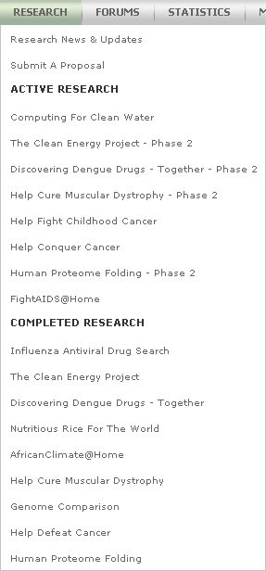

Adoption of Voluntary Grids
Awareness
Systems
Infrastructure Invisibility
Grid Adoption
Word of Mouth
Altruist Image
Personal Feedback
Teaming
(geographically, project, teams)
Hand-outs
(wallpapers, screensavers,
Social Media
8
Notes:
RW1

Slide 41
Appropriable Infrastructures
Awareness
Systems
Infrastructure Invisibility
Grid Adoption
Mainwaring et al.:
  Build and express their identities
Dourish et al.:
  Preserve visibility
  Support for multiple perspectives on information
  Make information sharing an application matter.
9

Slide 42
Seamful Design
Awareness
Systems
Infrastructure Invisibility
Grid Adoption
Chalmers et al.:
  Limits of sensing technologies: Seams
  Accuracy and certainty
  Designers ”hide” the seams and resort to default options
  Beautiful Seams: users reflect on the seams and adjust their own behavior.
10

Slide 43
Intelligbility
Awareness
Systems
Infrastructure Invisibility
Grid Adoption
Automatically generated explanations.
Increasing trust, acceptance and adoption.
why and why not questions provide the most benefit: understanding and trust.
11

Slide 44
Awareness Systems
Awareness
Systems
Infrastructure Invisibility
Grid Adoption
12

